Slide 1












Twinning Project
SUPPORT TO STRENGTHENING
THE HIGHER EDUCATION SYSTEM
IN AZERBAIJAN
ENI/2018/395-401
2018-2020
BRIEF INTRODUCTION
INTO MAIN STAKEHOLDERS

Slide 2
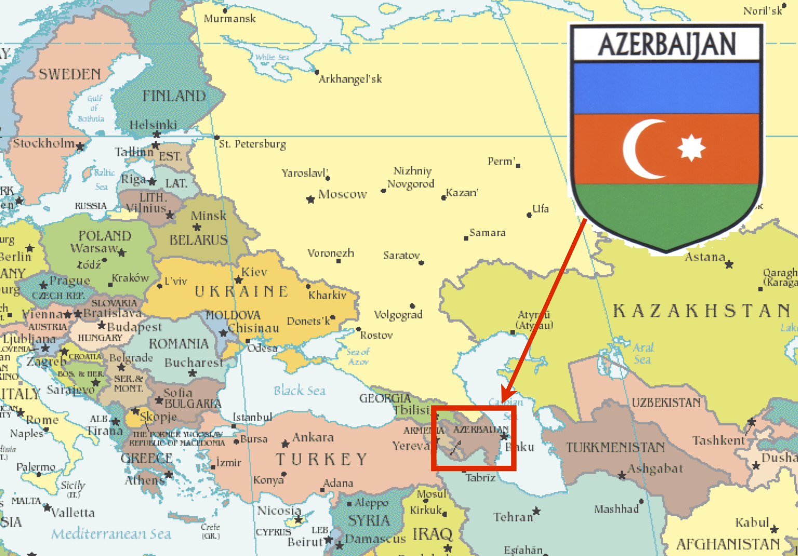
Azerbaijan in a world map

Slide 3
Key facts about Azerbaijan
Area - 86,600 sq. km; Population- 9.8 million
Capital - Baku; Language - Azerbaijani
Religion - Islam (95% Muslims, 3.1% Christians, 1.9% others)
Key sectors of economy - Energy (Oil & Gas), Agriculture, Tourism, Science and Technology
GDP - 40.75 billion US dollars as of 2017
Average monthly salary - 542 AZN as of Sept. 2018
Living cost – 173 AZN

Slide 4
Recent figures about higher education in Azerbaijan
Total number of HEIs - 51
Under Ministry of Education - 20
Under various ministries and committees - 13
Private - 11
Specialized -7 (academies, etc.)
Total number of students nationwide - 179,892
Bachelor level - 157,662
Master level - 13,442
Doctoral level - 2723
Foreign students - 6065 (mainly from Turkey, Russia, Georgia, Iran, Iraq, Bangladesh)

Slide 5
Main stakeholders of Twinning project in HE
Ministry of Education
Accreditation and Nostrification Bureau
Five pilot universities + three selected regional universities

Slide 6
Accreditation and Nostrification Bureau
Established – in April 2016 upon ministerial decree
Status – a public body attached to the Ministry of Education
Organizational structure –
- Accreditation Department
- Nostrification Department
- Information Department
Areas of activity -
- accreditation of educational institutions and their study programmes
- assistance to education institutions in carrying out the accreditation
- recognition of specialities of foreign higher education institutions and their nostrification
- recognition and determination of equivalence (nostrification) of documents awarded by foreign education institutions

Slide 7
Pilot universities + three regional universities
Pilot universities
Baku State University
Azerbaijan State Pedagogical University
Azerbaijan Oil and Industry University
Baku Engineering University
Azerbaijan Technical University
Regional universities
Ganja State University
Sumgait State University
Nakhchivan State University

Slide 8
University profile: Baku State University
Total number of students - 23,495
- Bachelor - 19,036; master – 1,300; doctoral – 645
Faculties - Mechaniscs & Math, Applied Math & Cybernetics, Physics, Chemistry, Biology, Ecology & Soil Science, Geography, Geology, Philology, History, Int’l Relations & Economy, Law, Journalism, Librarianship & Information, Oriental Studies, Social Sciences and Psychology, plus the Unit for SABAH Groups
Number of regional branches - 1 (Gazakh branch)
Number of study programmes - bachelor - 65; master – 44; doctor – 12
Existence of QA system - Quality Assurance, Monitoring and Evaluation Unit under the Education Department; established - in 2017
Joint diploma programme with international HEI – joint programme with University of Würzburg of Germany in European law. Not accredited so far.
Existence of Career Center - Center for Career, Internship and Links with Graduates. It has established links with mainly state institutions, Academy of Sciences, also some private institutions. Its main function is to arrange internship for students, build contacts with labor market and to help graduates to find employment.
Key research areas - Nanotechnology, Theoretical Physics, Biology, Chemistry, Semiconductor Physics, etc.

Slide 9
University profile: Azerbaijan Oil and Industry University
Total number of students – 12,471
- Bachelor – 10,297; master – 1,192; doctoral – 244
Faculties - Geological Exploration, Oil, Gas and Mining, Chemical Technology, Oil Mechanics, Power Engineering, IT and Management, Economics and Management, plus the Unit for SABAH Groups
Number of regional branches – N/A
Number of study programmes - bachelor - 44; master – 34; doctor – 41
Existence of QA system - Assessment and Quality Assurance Center; Established - in 2015
Joint diploma programme with int’l HEIs – joint programmes with University of Siegen of Germany and University of Georiga of U,S., both accredited by SIBA (Germany) and ASIIN. Also, French-Azerbaijan University (UFAZ), a joint project with the University of Strasbourg.
Existence of Career Center - Public Relations and Marketing Dept. deals with career issues of students as well.
Key research areas - Geophysics, Soil Cultivation, Natural Resources Mining Technologies, Cost-effective and Innovative Extraction Technology,, Nanotechnology, High-tech Energy Systems, Efficient Use of Water Resources, Smart Measurement Systems. Links mainly with the State Oil Company, Sumgait Chemical & Industrial Park and some other private manufacturing companies. ASOIU maintains links mainly with the State Oil Company, Sumgait Chemical Industry Park and many other private manufacturing companies in the field of research.

Slide 10
University profile: Azerbaijan State Pedagogical University
Total number of students – 10,600
- Bachelor – 9,812; master – 718; doctoral – 70
Faculties – Philology, History and Geography, Physics & Technology, Math & Informatics, Chemistry & Biology, Primary Education, Faculty of Pre-school Education, Psychological Service and Correctional Training, Faculty of Music, Fine Arts and Military Training, plus the Unit for SABAH Groups
Number of regional branches – 5
Number of study programmes - bachelor - 22; master – 19; doctoral – 24
Existence of QA system - Quality Assurance Unit; Established - in 2017; Reports directly to Rector. At the moment QA Unit participates in EU-funded ERASMUS+ project aimed at establishing and developing quality assurance centers in Azerbaijani universities.
Joint diploma programme with int’l HEIs – Not available at the moment.
Existence of Career Center – Alumni, Coordination and Career Unit at Education Dept.; established in January 2018. It has built links with a number of private educational and training centers.
Key research areas – There are over 50 research areas at ASPU. They can be summarized as follows: Computational Mathematics, Mathematical Analysis, Teaching Methodology of Informatics, Teaching Methodology of Physics, Solid Matter Physics, Molecular Transfer Phenomena in Liquids, Teaching Improvement, Ontogenesis and Physiological Mechanism of Neurohumoral System, Safety of Life Activities, Analytican Chemistry, Studying Flora and Fauna of Azerbaijan, Improvements in Content and Methodology of Teaching in Secondary Schools, Economic Geography, Histrory of Caucasian Nations, Teaching Methodology of Geography and History, Azerbaijani Literature, Modern Az. Language, Improvements in Foreign Language Study Programmes and Teaching Methodology at local HEIs, Improvements in Pre-school and Primary Education; No links with private sector in the field of research.

Slide 11
University profile: Baku Engineering University
Total number of students – 4,748
- Bachelor – 4,247; master – 447; doctoral – 31
Faculties – Engineering, Pedagogy, Economy & Management, plus the Unit for SABAH Groups
Number of regional branches – N/A
Number of study programmes - bachelor - 27; master – 22; doctoral – 9
Existence of QA system - N/A
Joint diploma programme with int’l HEIs – Not available at the moment.
Existence of Career Center – Department for Links with Companies and Career Issues.; established in March 2017. It has built links with major companies of the country specialized in the field of manufacturing (consumer goods, construction materials, furniture, industrial goods, etc.), IT, banking, accounting, industrial chemistry, construction, as well as with a number of state institutions like State Oil Company, Sumgait Chemical Industry Park, certain state committees and branches of some foreign companies in Azerbaijan.
Key research areas – There are up to 20 research areas at BEU. They can be summarized as follows: The Structure of Substances, Structure of Nanoparticles and Their Spectroscopic Properties, Spectral Properties of Differential Operators, Synthesis of Nitrogenous, Heterocyclic Compounds through Green Methods, Study of Literary Language in Literature, Practical and Methodical İssues of Foreign Languages Teaching, Increasing the Effectiveness of İnformation Systems in Terms of Security of Data Processing, Sharing and Analysis, Modern Problems of Science of Architecture and Construction in Azerbaijan, Education in Accounting and Auditing on Global Level, Strengthening Local Self-governance in Azerbaijan, International Security Problems and Foreign Policy of Azerbaijan, Innovative Non-oil Sector Development: World Experience and Opportunities of İts Application in Azerbaijan, Increasing Business Efficiency, Effective Management of Financial Resources.

Slide 12
University profile: Azerbaijan Technical University
Total number of students – 8,381
- Bachelor – 7,477; master – 657; doctoral – 139
Faculties – Transportation, Electrotechnics and Power Engineering, Radiotechnics & Communication, Metallurgy, Machine Building, Automatics & Computer Technology, Special Technology, Engineer Business and Management, plus the Unit for SABAH Groups
Number of regional branches – N/A
Number of study programmes - bachelor - 37; master – 33; doctoral – 31
Existence of QA system - Assessment and Quality Assurance Unit at Education Dept.; established in May 2017. It oversees the overall quality of education and teaching process, analyzes strength and weakness of teaching, assesses the level of performance of the academic staff and conducts regular surveys within the university. Submits the data collected directly to the university management.
Joint diploma programme with int’l HEIs – AzTU has signed cooperation agreements with a number of foreign HEIs such as Alexandru Ioan Cuza University of Romania, Ankara University of Turkey, Odessa National Academy of Telecommunications of Ukraine, EPITA Engineering School of France, University of Girona of Spain, University of Reims Champagne-Ardenne of France, St. Petersburg State Institute of Technology of Russia and joint diploma programmes are planned to be launches with those universities in future. It is also a part of EU-funded ERASMUS+ project aimed at establishing and developing quality assurance centers in Azerbaijani universities.
Existence of Career Center – Career Center was established in May 2016. It has built links with major public and private companies like “Azerbaijan Coca-Cola BOTTLERS LLC”, “Carlsberg Group”, “Ulduz” chocolate factory, Sumgait Technology Park, British Petroleum, Sangachal Terminal, Bakcell, Azercell, Azersun Holding, Gilan Holding, State Oil Company, Baku Metro LLC, Azerishiq (national power supplier), institutes of the National Academy of Sciences of Azerbaijan, etc.
Key research areas – Machine building, Electrotechnics & Power Eng., Radiotechnics, Metallurygy and Material Studies, Automatics, Transportation, Technology of Instrumentation, Natural Sciences, Telecommunication, Humanities, Modern Machines and Equipment, Tribotechnics, Robots and Manipulators, Metallurgy of High-strength Alloys, Cyclic Compounds, Management in Hierarchical Industrial Systems, Renewable Energy Sources and Energy Machinery and Hydrodynamics Processes. AzTU mainly cooperates with research institutes of the National Academy of Sciences of Azerbaijan (Management Systems Ins., Math and Mechanics Ins., Radiation Problems Ins., Ins. of Catalysis and Inorganic Chemistry, Astrophysics Observatory, etc.) in the field of research.

Slide 13
University profile: Ganja State University
Total number of students – 6050
- Bachelor – 5573; master – 315; doctoral – 162
Faculties – Biology/Chemistry, Math/Informatics, Physics and Technical Sciences, Pedagogy, History/Geography, Foreign Languages, Economy and Management, Philology, Further Education
Number of regional branches – N/A
Number of study programmes - bachelor - 41; master – 40; doctoral – 29
Existence of QA system - No QA center at GSU at the moment. It is under construction as part of the EU-funded ERASMUS+ project aimed at establishing and developing quality assurance centers in Azerbaijani universities. Instead, currently there is Strategic Analysis, Assessment and Monitoring Department which partially executes duties of the QA Center.
Joint diploma programme with int’l HEIs – No joint diploma programmes at the moment. GSU is currently at the stage of talks with a number of Turkish universities on establishing joint degree programmes.
Existence of Career Center – Internship and Career Center. Established: in 2012. Its main responsibility is to arrange internship for students and organize job fairs for students to help them to find employment.
Key research areas – Problems of Azerbaijani Language, Modern Pedagogy, Humanities, Floral Biodiversity in Western Azerbaijan, Modern Problems of Inorganic and Organic Chemistry, Geographical Problems in Ganga Area, Increasing Economic Efficiency, Formation of Regional Infrastructure in Azerb., Modern Research Methods in Physics and Chemistry, Development of Cognitive Processes in Schoolchildren, Pedagogical and Social Psychology, Physical Training, Comparative Teaching of Foreign Languages, Child Psychology.

Slide 14
University profile: Nakhchivan State University
Total number of students – 5827
- Bachelor – 5346; master – 328; doctoral – 153
Faculties – History/Philology, Physics/Math, Int’l Relations and Foreign Languages, Medicine, Social Management and Law, Natural Science and Agriculture, Pedagogy, Architecture and Engineering, Economics, Arts, Dean’s Office for Foreign Students, Master Studies Department
Number of regional branches – N/A
Number of study programmes - bachelor - 60; master – 64; doctoral – 47
Existence of QA system - No QA system at NSU at the moment. QA Center existed at the university in 2001-2002 as part of the project financed by the U.S. Embassy in Azerbaijan.
Joint diploma programme with int’l HEIs – NSU is currently at the stage of talks with Çankırı Karatekin University and Igdir University of Turkey to establish joint diploma programmes.
Existence of Career Center – No Career Center at NSU. However, based on governmental decision, various state institutions (ministries, committees, etc.) act as custodians for relevant study programmes at NSU and employ high-performing students upon graduation.
Key research areas – Technical Sciences, Mathematical Sciences, Physical Sciences, Chemical Sciences, Geography, Biological Sciences, Medicine and Heath, Philosophy, History, Economy, Politics, Legal Sciences, Pedagogy, Philology, Art Studies, Urban Planning and Architecture . The research in the field of Economy, Agriculture, Tourism and Hospitality, Architecture is carried out in close cooperation with relevant ministries and committees.

Slide 15
University profile: Sumgait State University
Total number of students – 6144
- Bachelor – 5733; master – 300; doctoral – 111
Faculties – History and Geography, Economy and Management, Math, Engineering, Physics and Power Engineering, Chemistry and Biology, Philology
Number of regional branches – N/A
Number of study programmes - bachelor - 42; master – 33; doctoral – 19
Existence of QA system - Assessment and Quality Assurance Center established in 2016. It is part of the EU-funded ERASMUS+ project aimed at establishing and developing quality assurance centers in Azerbaijani universities.
Joint diploma programme with int’l HEIs – No joint diploma programmes at the moment. But three study programmes - Process Automation, Energy Management, Economy – have been accredited by ASIIN as part of the EU-funded TEMPUS project.
Existence of Career Center – Career Center was established in 2016. The main duties of the Center is to create electronic database of students, to develop business incubation mechanism for students, to organize job fairs, to arrange internships for students, to offer consulting services and to develop projects in a variety of fields.
Key research areas – Technology, Chemistry and Physics. At the moment SSU does not maintain any links with private sector in the field of research.

Slide 16
For more info about Twinning project, please consult: twinning4he.edu.gov.az https://www.facebook.com/twinningInHE/

