Slide 1
Learning outcomes
Definition
•Statements of what a student should know, understand and/or be able to demonstrate after completion of a process of learning(ECTSUsers’Guidep.47)
•Set for both study programme and each study subject.
•Formulated by teachers together with internal and external stakeholders of HEI.
LO must be:
•achievable and corresponding study level;
•simply and clearly described;
•capable of being validly assessed.

Slide 2
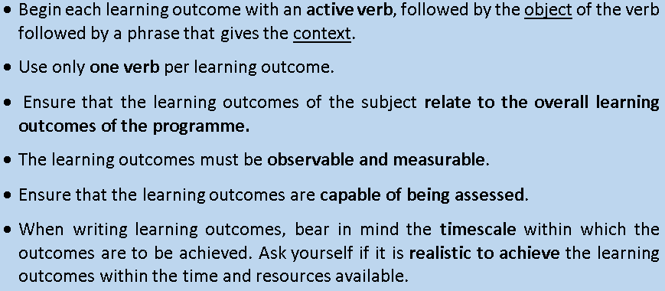
Writing Learning outcomes

Slide 3
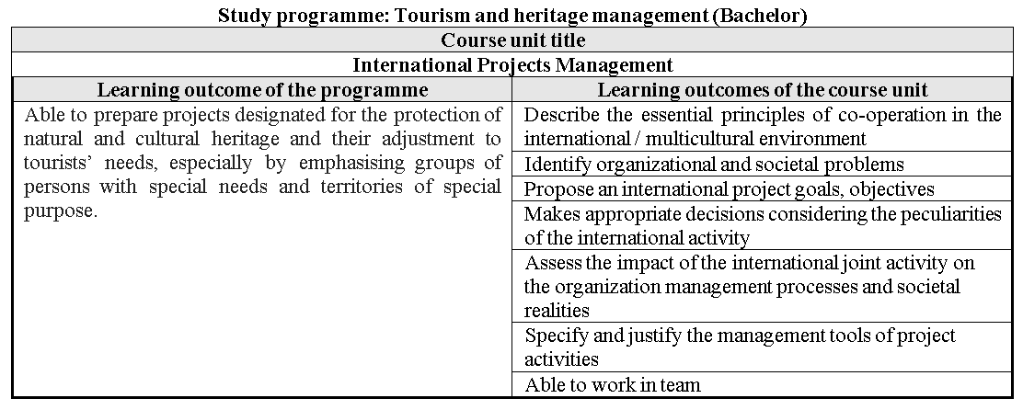
Example

Slide 4
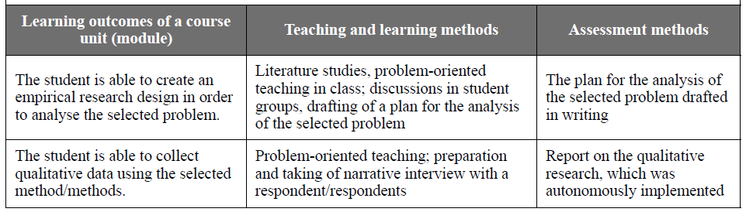
Linking Learning Outcomes, Teaching and Learning Activities and Assessment

