Slide 1




Training of External Reviewers
Rasa Penkauskiene Centre for Quality Assessment in Higher Education Lithuania | Jolanta Silka Academic Information Centre Latvia
12 September 2019
  Twinning project “Support to strengthening the higher education system in Azerbaijan” (No AZ/14/ENI/OT/01/17 (AZ/49))
This project is funded by
the European Union

Slide 2
Outline
Introduction
Session 5: Writing evaluation report
Session 6: Practical exercise on how to write good recommendations

Slide 3
General Steps of Procedures
1. Self-assessment process
2. Submission of the application and self-assessment report
3. Review of the documents by the Agency
4. Composing the experts group
6. Visit of the experts group
7. Joint report of the experts group
8. Comments by HEI on the factual errors
9. Decision by the Committee (with the HEI present)
10. Follow-up procedures
5. Experts work before the site visit

Slide 4
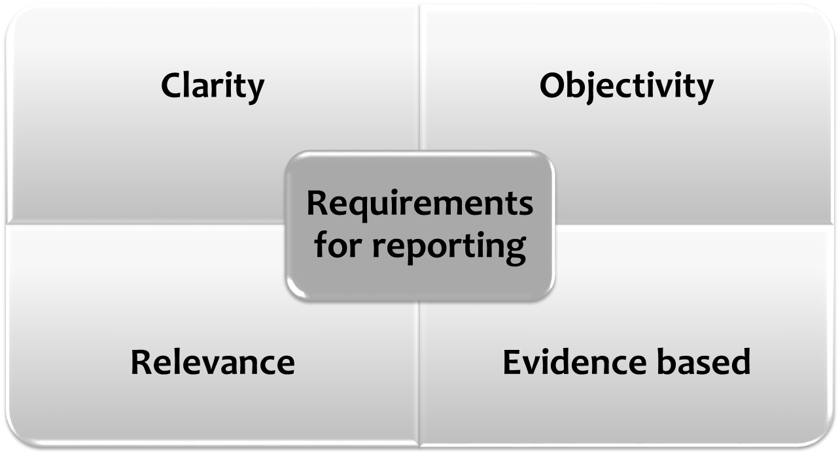
ESG 2.6 Reporting Standard:
Full reports by the experts should be published, clear and accessible to the academic community, external partners and other interested individuals.

Slide 5
Writing evaluation report
Session 5

Slide 6
Requirements set in the Methodology
The joint report shall be prepared by the experts group:
according to the template provided by ANO (in the Methodology)
justifying the made statements and providing references and evidences from the self-evaluation report or the site visit
in accordance with the literary and grammar rules of language, legal and academic terminology
providing recommendations for improvement of study programme and its implementation.

Slide 7
Key points for writing report:
Preparing the report, the experts group shall assess all evaluation criteria according to the evaluation areas specified in the methodology
Each assessment criterion is followed by aspects which are to be taken into account when assessing the relevant criterion.
The experts group may assess other aspects which are significant for assessment of the relevant criterion.
Assessing each criterion, the experts group shall analyse the information available for the experts group, giving concrete examples and references to the self-evaluation report and information obtained during the visit.
The experts group shall analyse each criterion and make conclusions, specifying strengths and weaknesses of the higher education institution with regard to meeting the assessment criterion in the study programme.
Preparing its joint report about the study programme, the experts group shall agree on the assessment.
If the opinion of experts regarding any of the criteria differs, the different opinion shall be specified in the joint report.

Slide 8
Structure of Evaluation report:
Information on evaluated study programme Summary (of the assessment) IntrODUCTION STUDY PROGRAMME ANALYSES Programme aims and learning outcomes Curriculum design Teaching staff Facilities and learning resources Study process and students‘ performance assessment Programme management GENERAL ASSESSMENT REMARKS OF THE EXPERTS GROUP ON THE STATE STANDARD

Slide 9
Introduction
Information in line with the template provided by ANO
Background of the evaluation process
Expert group (information on the experts)

Slide 10
Study programme analysis
6 evaluation areas. For each evaluation area:
Comments (analyses) A short description of the situation in the study programme, based on elements from the self-evaluation report and on findings from the site-visit indicating the compliance and/or not-compliance with standards.
Strengths A list of strengths – examples of good practices, excellent achievements, innovative solutions..
Weaknesses A list of weaknesses – problem areas (and non-compliances, if applicable) to be dealt with.
Recommendations Recommendations of how to address the weaknesses and on further improvements, for elimination of the deficiencies found, as well as long-term recommendations for further improvement of the study programme.
Evaluation results

Slide 11
Analysis of the programme
Comprehensive but avoid unnecessary information
Evidence-based:
The contents of several courses need to be updated and modernized. – Which courses? Why?
As far as pedagogical or didactic support, the self-evaluation report does not give any information. – What was found out during the visit?
There is no highlighted direct relation with study programme outcomes and subject learning outcomes in some subject descriptions. – Which descriptions?

Slide 12
Be conscious of your language!
Avoid conditional sentences, deliver a clear message
Do not be too prescriptive;
Avoid using specific cultural contextual references;
Do not extend sentences across many lines.

Slide 13
Analysis of the programme
! Evaluation report should not repeat information provided in the SER;
! Evaluation report should not be descriptive but analytical;
! Factual information about the study programme should be correct;
! Not only weaknesses but also strengths should be emphasized;
! Enough attention should be devoted to the conclusions;
! Attention to be paid how recommendations of previous evaluation
were implemented.

Slide 14




Example: Evaluation area 4
Facilities and learning resources
Premises, treaching and learning equipment
Facilities for internshp
Financing
Teaching materials,
Library resources, data bases

Slide 15
Example: Evaluation area 6
Programme management
Is quality management system in place? What documents regulate it?
How does it work in reality?
Is it effective for study programme management?
Are the roles and responsibilites of involved parties clear?
Are students and employers representatives involved in the management of study programme?
Who are the members of the Appeals committee? How many cases were so far? What are the results of the appeals?
Does strengths and weaknesses indicated in the SER reflect to the reality?

Slide 16

Extract form experts report:
«One cannot conclude from the submitted documentation that the outcomes of research elaborated in the University has been published in internationally reviewed editions and that collection of articles published by the university is included in internationally reviewed and acknowledged data bases.»
- vague, uncertain,
what have experts done for checking it?
do experts ask this information?

Slide 17

Examples of good practice
Two foreign languages are not present in curricula (as required by the professional standard subsection 3.55), but experts propose to defer conformance to this professional standard requirement and rather invite the Ministry of Education and Science to revisit the professional requirement.
Name of “Computer graphics” course does not correspond to the content. In IT programmes it would usually includes mathematical foundations of computer graphics, rather than usage of image processing programs.
The admission rules are clearly described and fully compliant with the programme, however they are not publicly available and therefore hard to examine in practice. Student and administration interviews support this conclusion.

Slide 18
Evaluation report requires time and effort
drafting
editing
agreeing
ESG: „The factual accuracy of a report is improved if the Institution is given the opportunity to point out errors of fact before the report is finalized.“

Slide 19
Target audiences of the external evaluation reports
For HEI
For students
For the public
For the Agency

Slide 20
Practical exercise on how to write good recommendations
Session 6

Slide 21
Key points for Experts recommendation:
provide recommendations for any identified problem/ weakness in the study programme
understandable and measurable (can be detected if recommendation is implemented)
separated by the time required for implementation (short-term or long-term)
make clear what it is about or to whom it is addressed
based on good practice in the field and worldwide

Slide 22
Exercise 1
Read the recommendations list
Answer to the question:
  Are the recommendations:
    Clear
    Measurable
    Is it possible to understand the term for implementation

Slide 23
Exercise 1: Is a recommendation good?
If HEI is planning to offer the study programme to foreign students, the homepage information should be reviewed and better offered.
The correlation between the study learning outcomes and study course learning outcomes should be improved.
Information on the procedures of the quality management system should be communicated to all the interested parties.
Subject description, their alignment with learning outcomes should be improved.

Slide 24
It would be useful to start to take this study programme on video conference base too; it would help to increase the number of students.
Continue to improve English language skills of the staff and students. Administration needs to motivate academic staff to participate in scientific conferences and use opportunities that the HEI offers them (free English language courses).
Enhance research aspects for academic staff and students’ involvement in research activities.
We recommend that the administration would review ways to motivate lecturers or replace them if the quality of their work is lacking.

Slide 25
Exercise 1: Is a recommendation good?
The academic staff should be involved in the definition and improvement of the formal procedure of the development and improvement of the study subjects.
If the master study programme admits students from different faculties with different previous studies, it should be ensured that gaps of some students are clearly identified before their admission and that additional courses are offered to cover these gaps and simplify the students’ integration in study programme without causing overlaps with the HEI’s own Bachelor programme in the same field.
Proactive strategy for study programme internationalisation should be developed and implemented.
Research is very weak, HEI is only looking for directions and qualified staff.

Slide 26
Technical and didactic support for e-learning should be improved.
Publishing policies should be elaborated.
The study programme management should consider the motivation instruments to involve both the students and the academic staff in mobility programs.
Higher involvement of employers would be beneficial for the professional programme.

Slide 27
Exercise 2
Writing a good recommendation
Each group writes 2 recommendations for the certain evaluation area
Present your recommendations
Discussion

