Slide 1
Formulation of Learning Outcomes and Mapping
Prof.Tatjana Koķe, Vice rector RSU, Latvia
The EU Twinning Project
Support to strengthening HE System in Azerbaijan
2018-2020; Activity 1.5
2019. 02. Baku

Slide 2
Learning outcomes of this session
Learning outcomes of the session:
Identify weaknessess of the current Study Programs/Courses
List major LO of your study course
Identify resources which may help to formulate LO
Discover value of mapping as a means for improvement of StP/StC

Slide 3
Being a good coach
Team work
Communication
Listening well
Adaptability,
flexibility,
entrepreneurship
Broad
Learning skills
Possessing insights into others
Able to make connections across complex ideas
Learning to learn
Good critical thinker,
Problem-solver
Having empathy being supportive
michiganfuture.org

Slide 4
Some reasons for the weaknessess:
Vague connections to employers
Lack or out dated occupational standarts
Faculty orientation towards subject instead of students and their learning outcomes
Curriculum focus on knowledge instead of its application
Less developed assessment methods for skills evidence

Slide 5
What are LO?
LO are statements of what a student is expected to know, understand and/or be able to demonstrate after completion of a process of learning in order to meet complex demands.
Formulation of LO is a prerequisite to implement change from subject and teacher –centered education to student centered learning. It means that:
At the centre of study process is student who is able to learn independently;
LO are clearly formulated and known to students who study in order to attain them;
Students are aware, involved and they understand formulated LO at each study course and program;
Learning activities are implemented in a way that helps to achieve LO;
Student performance assessment allows to make sure that students have achieved their LO and at what level;
Faculty role is to stimulate students learning in order to achieve LO.

Slide 6
How to write LO
LO should be observable and measurable.
Clear understanding of what LO and how will be assessed should be stated (how student will be able to demonstrate achieved LO and What will serve as a proof that LO is achieved).
LO should be attainable within the time frame of course or program
Unclear and general statements should be avoided , e.g.–know, improve, get acquainted, be familiar with, be exposed to, be acquainted with, be aware of, etc. These terms are associated with teaching objectives rather than learning outcomes.

Slide 7
What do LO promote?
Unanimous understanding both for students and faculty what is expected to be achieved by the end of course or program;
Students efficiency as they have clear understanding what they need to obtain in terms of knowledge, skills, attitudes and values in order to cover the program successfully;
Organisation of study process more efficiently by choosing appropriate themes, materials, learning activities that suit achievement of LO;
Faculty members to develop common understanding on most efficient methods for achieving proposed LO;
Provision of clear information for employers on what graduates have attained within the program in accordance with the requirements of professional qualification.

Slide 8
Structure of LO
LO – unity of knowledge, skills and competences acquired during study process and is able to demonstrate this unity.
Knowledge: the outcome of the assimilation of information through learning, work and life experience;
Skills: ability to perform activities at adequate level and quality;
Competence: flexible and dynamic unity of knowledge, skills, attitudes, values and emotions to perform required activities.

Slide 9
Bloom’s taxonomy in defining LO
Benjamin Bloom’s (Benjamin Bloom, 1956) taxonomy is often used to define LO.
According to this approach, education is acquired through six hierarchic levels, where each level corresponds with particular ability, starting from the lowest – knowledge or remembering of the facts, to higher levels such as analysis and evaluation.
Evaluation
Synthesis
Analysis
Knowledge
Application
Comprehension

Slide 10
Bloom’s taxonomy in defining LO
Knowledge – the ability to remember facts without the need to understand them (recalling facts, terms, basic conceptions, answers, definitions, rules and perceive particular information).
Comprehension – the ability to understand and interpret the acquired information (comparing, interpreting and summarizing demonstrates the understanding and processing of facts and ideas and the level of comprehension).
Application – the ability to use a concept in a new situation or unprompted use of abstraction (using existing knowledge, facts, abilities, strategies and rules in new situations or different ways).
Analysis – the ability to divide material into component parts so that its organizational structure may be understood, distinguishing between facts and inferences (dividing information into parts, finding causes and motives, proving comprehension of coherence.
Synthesis – the ability to join several parts, ideas, concepts, methods creating a whole or a new approach (summarizing information, finding alternate solutions to a problem, combining existing knowledge in new ways, creating original conclusions and opinions and using them in problem solving).
Evaluation – the ability to judge the usefulness of the material corresponding to its’ goals (evaluating the content, knowledge, conception according to the stated criteria).

Slide 11
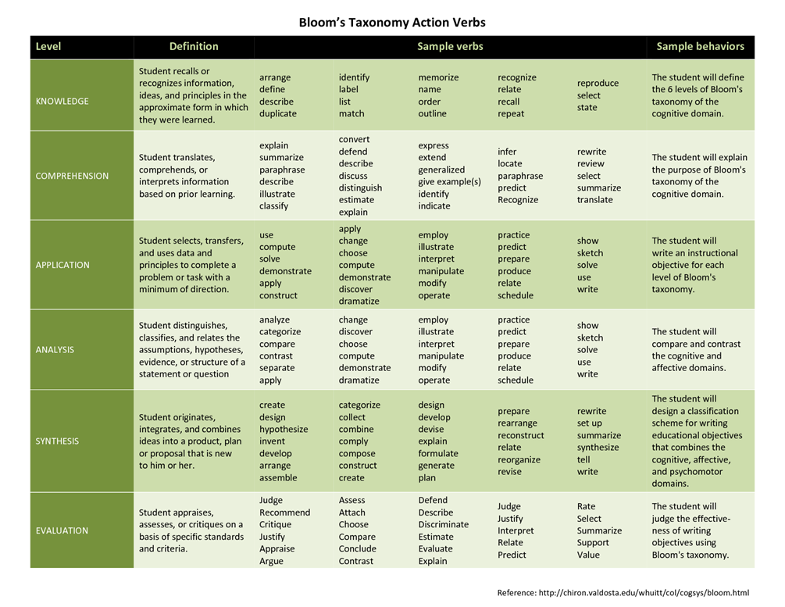

Slide 12
Examples of LO
Knowledge:
  Identify and consider ethical implications of scientific investigations.
  Define what behaviours constitute unprofessional practice in the teacher – parent relationship.
  List the criteria to be taken into account when caring for a pupil with delinquent behaviour.
Comprehension:
  Explain the social, economic and political effects of World War I on the post-war world.
  Classify reactions as exothermic and endothermic.
Application:
  Construct a timeline of significant events in the history of Australia in the 19th century.
  Apply knowledge of infection control in the maintenance of patient care facilities.of evidence-based medicine to determine clinical diagnoses.

Slide 13
Examples of LO
Analysis:
  Compare and contrast cognitive and constructive learning approaches.
  Debate the economic and environmental effects of energy conversion processes.
Synthesis:
  Propose solutions to complex energy management problems both verbally and in writing.
  Summarise the causes and effects of the 1917 Russian revolutions.
Evaluation:
  Predict the effect of change of temperature on the position of equilibrium.
  Summarise the main contributions of Michael Faraday to the field of electromagnetic induction.

Slide 14
Mapping of LO: case of RSU

Slide 15
Unity of Quality Assurance Policy and Strategic Management
Programme development, implementation, modernisation
Student- centred learning
Quality assurance policy
Continuous
professional
development
Partnership
Management, incl.information
Resources, incl.human,
IT, etc.

Slide 16
Monitoring of the quality of StP content
TEACHING
GOALS AND TASKS
CONTENT
ASSESSMENT
LEARNING

Slide 17
1.planning
2.implementation
3.monitoring
4.assessment
IDENTIFY RELEVANCE
ASSESS TOTAL FRAME
ANALYSE THEMATIC COVERAGE
IMPROVE SEQUENCE OF CONTENT, ITS SCOPE AND CONFORMITY
ANALYSE BALANCE OF THEORY AND PRACTISE
DETERMINE CREATIVITY/ DEFICIT

Slide 18
What is «mapping»
Mapping – validation of components of one cluster to another cluster’s components, depicting sequence, compatability and linkage of these components.
Program map is visual reflection of program structure.
Program map includes content, resources, teaching/learning and assessment methods, thus, allowing to forsee how the LO will be achieved.
Revealing the connections between different program components, mapping shows that program LO is more that just the sum of its seperate parts.

Slide 19
Aim of Mapping StC towards StP LO
To depict how each study course fits in the study program and ensures to achieve program LO.
  All included study courses ensure to achieve program LO;
  The most important results are achieved by acquisition of compulsary study courses;
  Achievement of LO is sequent and logical;
  Learning activities meet LO.

Slide 20
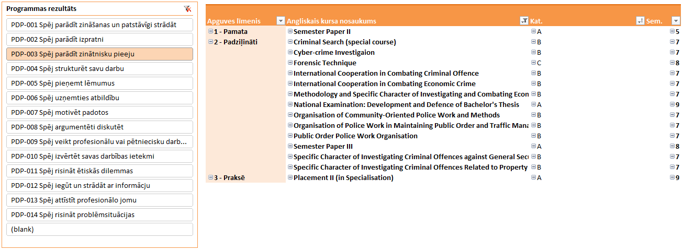
Riga Stradiņš University

Slide 21
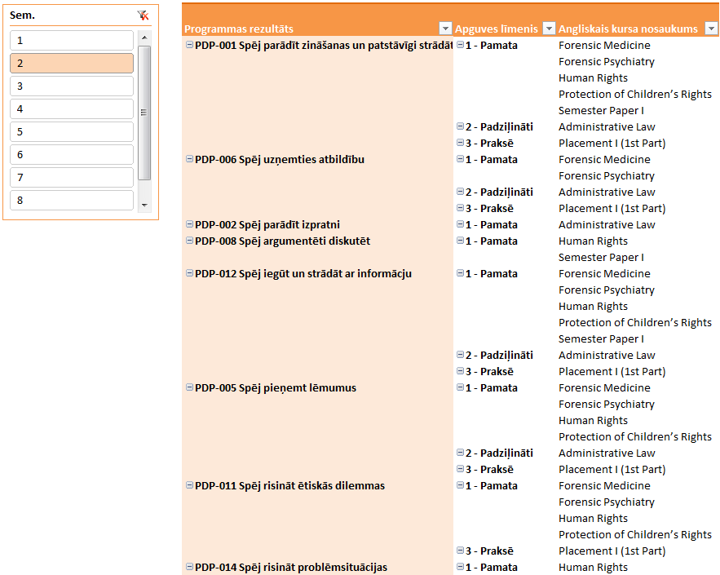
Riga Stradiņš University

Slide 22
Mapping: results –
Bachelors programme «Physical Therapy»
To acquire basic and specialized knowledge in research methodology in order to participate in research projects and conduct innovations in the profession.
English in Rehabilitation
History of Medicine
Biometrics
Methods of Research I
Methods of Research II
Writing Bachelor’s Thesis and its Defence
On successful completion of the course, the students will be able to:
use appropriate language devices to communicate their ideas both in written and spoken language;
summarize the information from any kind of source in written and spoken language using relevant terminology in English;
retell the general idea and specific information in different kinds of texts.
As the result of study course student will be able to:
formulate and justify a research problem;
prepare and defend the proposal for bachelor thesis;
increase skills in a systematic search of the scientific literature and critical analysis of scientific publications in field;
look for scientific evidence to answer clinical questions.
Upon successful acquisition of the course, the students will be able:
- to research and evaluate historical sources,
- gather and critically evaluate facts about discoveries, events and processes in the development of medicine,
- systematize and make theoretical generalisations.
Upon successful acquisition of the course, the students will be able to:
create and interpret scatter plots and histograms;
draw a normal distribution and calculate its main parameters;
compute and interpret simple linear regression between two variables;
calculate regression coefficient and Pearson’s or Spearmen’s coefficient of correlation;
draw and analyse Kaplan-Meier survival curve.
Participates in research and the development of physical therapy as a science, using the principles of evidence-based practice.
Uses different activities according to the needs of society, explaining the link between occupations, health and well-being.
Understands and applies strategies for provision of services at regional level, according to health and social needs.
As the result of study course student will acquire basic skills in:
formulation of research questions;
independent scientific literature searching,
critical review of scientific publications;
understanding, choosing and justifying appropriate research design and methodology, taking into account the ethical aspects;
writing a research report.

Slide 23







Weaknesses of graduates
Research activities
Skills
Apply creative and innovative solutions
Build on and connect diverse disciplines
Fear
of Risk
taking
Failing to move beyond personal curiosity
Synthesise analyse and evaluate
ideas
Not establishing priorities
Use critical and creative thinking skills
Apply ethical frameworks
Poor project management
Not seeing the big picture
Plan and develop research projects
Use research methods from diverse disciplines
Lacking openness to other problems and needs
Demonstrate communication skills
Not
valuing
time
Poor «people skills»
Reflect on
the learning process

Slide 24
Fear
of Risk
taking
Moving
beyond personal curiosity
Synthesise analyse and evaluate
ideas
Establishing priorities
Poor project management
Seeing
the big picture
Lacking openness to other problems and needs
Not
valuing
time
Poor «people skills»
Notes:
Do the demands put on today’s HE are justified by its graduates? What does research and everyday practice show? One example…
US employers survey from Nicolas 2008 Researchers for tomorrow. University affairs. January 7. no Tacing Stock.Research on Teaching and learning in HE. Edit.by J.Ch.Hughes &J.Mighty. P.104. Learning ecology
It’ s clear we cannot be satisfied by the finding? What shoud be done?
The StP should provide opportunities for students to develop experience and skills as follows:
- Synthesise, analyse and evaluate ideas, methodologies, concepts, issues and knowledge – to develop ability to see big picture
· Apply ethical frameworks that underpin relevant disciplinēs – to move beyond personal curiosity in a legal way
· Plan and develop research projects – to develop project management skills
· Reflect on the learning process – learn to establish priorities
· Demonstrate interpersonal and communication skills – enrich people skills
· Build on and connect, concepts and skills from diverse disciplinēs – big picture and openness
· Use inquiry and research methods from diverse disciplines to identify problems and to research solutions – establish priorities and ability to see big picture
· Use critical and creative thinking skills to synthesise methodologies and insights from a variety of disciplinēs – risk taking
· Demonstrate collaboration and build mentoring relationships within the community
· Apply creative and innovative solutions to real life contexts. –establish priorities and value time
emphasize internal assessment, so the students gain experience in preparing research reports or papers, publishing research results in peer-reviewed journals, as well as presenting their work at conferences, delivering oral or poster presentations etc. “ (Tranter, 2007; Velez, 1996; Robertson & Bond, 2005; Boud & Lee, 2005).
Teaching and learning activities for integrated studies :
Critical literature review (content analysis);
Research project development (individual or group work);
Research projects including various experiments;
Independent group/individual projects;
Data simulation;
Participation in science conferences;
Research papers;
Research reports;
etc.

Slide 25
Fear
of Risk
taking
Moving
beyond personal curiosity
Synthesise analyse and evaluate
ideas
Establishing priorities
Apply ethical frameworks
Excellent project management
Seeing
the big picture
Lacking openness to other problems and needs
Not
valuing
time
Good
«people skills»
Notes:
Do the demands put on today’s HE are justified by its graduates? What does research and everyday practice show? One example…
US employers survey from Nicolas 2008 Researchers for tomorrow. University affairs. January 7. no Tacing Stock.Research on Teaching and learning in HE. Edit.by J.Ch.Hughes &J.Mighty. P.104. Learning ecology
It’ s clear we cannot be satisfied by the finding? What shoud be done?
The StP should provide opportunities for students to develop experience and skills as follows:
- Synthesise, analyse and evaluate ideas, methodologies, concepts, issues and knowledge – to develop ability to see big picture
· Apply ethical frameworks that underpin relevant disciplinēs – to move beyond personal curiosity in a legal way
· Plan and develop research projects – to develop project management skills
· Reflect on the learning process – learn to establish priorities
· Demonstrate interpersonal and communication skills – enrich people skills
· Build on and connect, concepts and skills from diverse disciplinēs – big picture and openness
· Use inquiry and research methods from diverse disciplines to identify problems and to research solutions – establish priorities and ability to see big picture
· Use critical and creative thinking skills to synthesise methodologies and insights from a variety of disciplinēs – risk taking
· Demonstrate collaboration and build mentoring relationships within the community
· Apply creative and innovative solutions to real life contexts. –establish priorities and value time
emphasize internal assessment, so the students gain experience in preparing research reports or papers, publishing research results in peer-reviewed journals, as well as presenting their work at conferences, delivering oral or poster presentations etc. “ (Tranter, 2007; Velez, 1996; Robertson & Bond, 2005; Boud & Lee, 2005).
Teaching and learning activities for integrated studies :
Critical literature review (content analysis);
Research project development (individual or group work);
Research projects including various experiments;
Independent group/individual projects;
Data simulation;
Participation in science conferences;
Research papers;
Research reports;
etc.

Slide 26
Strengths of PhD holders
Research activities
Skills
Risk
taking
Moving
beyond personal curiosity
Synthesise analyse and evaluate
ideas
Establishing priorities
Establishing priorities
Excellent project management
Apply ethical frameworks
Seeing
the big picture
Reflect on
the learning process
Openness
to other problems and needs
Valuing
time
Good
«people skills»
Notes:
Do the demands put on today’s HE are justified by its graduates? What does research and everyday practice show? One example…
US employers survey from Nicolas 2008 Researchers for tomorrow. University affairs. January 7. no Tacing Stock.Research on Teaching and learning in HE. Edit.by J.Ch.Hughes &J.Mighty. P.104. Learning ecology
It’ s clear we cannot be satisfied by the finding? What shoud be done?
The StP should provide opportunities for students to develop experience and skills as follows:
- Synthesise, analyse and evaluate ideas, methodologies, concepts, issues and knowledge – to develop ability to see big picture
· Apply ethical frameworks that underpin relevant disciplinēs – to move beyond personal curiosity in a legal way
· Plan and develop research projects – to develop project management skills
· Reflect on the learning process – learn to establish priorities
· Demonstrate interpersonal and communication skills – enrich people skills
· Build on and connect, concepts and skills from diverse disciplinēs – big picture and openness
· Use inquiry and research methods from diverse disciplines to identify problems and to research solutions – establish priorities and ability to see big picture
· Use critical and creative thinking skills to synthesise methodologies and insights from a variety of disciplinēs – risk taking
· Demonstrate collaboration and build mentoring relationships within the community
· Apply creative and innovative solutions to real life contexts. –establish priorities and value time
emphasize internal assessment, so the students gain experience in preparing research reports or papers, publishing research results in peer-reviewed journals, as well as presenting their work at conferences, delivering oral or poster presentations etc. “ (Tranter, 2007; Velez, 1996; Robertson & Bond, 2005; Boud & Lee, 2005).
Teaching and learning activities for integrated studies :
Critical literature review (content analysis);
Research project development (individual or group work);
Research projects including various experiments;
Independent group/individual projects;
Data simulation;
Participation in science conferences;
Research papers;
Research reports;
etc.

Slide 27
Conclusions
Study programms should undergo permanent changes. Mapping is a valuable tool to implement changes meaningfully.
Competence based curriculum:
  helps to convert weaknesses into strengths
  provides valuable life skills due to status change of students and lecturers
  enriches study environment
  promotes intrinsic learning motivation
  widens experience outside university and international cooperation
  demands organizational change

Slide 28
Thank you for your attention!

