Slide 1
Activity 1.6 Provide recommendations for improvement of methodology for developing national classifications of programmes in higher education
Gintautas Jakštas
2019 04 23, Baku

Slide 2
Outline
Motives for change classification and structure and principles of preparation (LT case)
Classification comparison
Classification Mapping
Summary

Slide 3
Why did Lithuania change their classification?

Slide 4
Motives for change in Lithuania
Many study programs whose titles do not correspond to the degree awarded;
Possibilities of organizing interdisciplinary studies are not foreseen;
There was no mechanism for changing the classification of studies;
Many study fields and branches with no programs registered;
Part of the study programs are registered in study fields and branches that do not correspond to their content.

Slide 5
Principles for new classification
Compromise halfway between science classification and labor market needs;
The classification is not related to the cost of studies;
Interdisciplinarity;
Possibility to include new study fields;
Broad qualification degrees;
Comparability with foreign academic practice.

Slide 6
Structure of Lithuanian Classification
Old classification (2010y):
Study Areas (6)
study field groups (15)
study field (139)
study branches (568)
New classification (2017y):
Study field groups (16)
Study fields (106)
Why do we need different levels in classification?:
Statistics
International comparison
Administration purposes (financing, planning, etc.)
Mapping with other classifications

Slide 7
Comparison of Azerbaijan specialties classification with Lithuanian and ISCED

Slide 8
Comparison of AZ and LT classification
Group of Specialities AZ | Group of Specialities LT
NATURAL SPECIALTIES | Mathematical Sciences
 | Physical Sciences
 | Life Sciences
 | Engineering
 | Computer Sciences
TECHNICAL AND TECHNOLOGICAL SPECIALTIES | Technological Sciences
MEDICAL EDUCATION SPECIALTIES | Health Sciences
 | Sport
HEALTH, WELFARE AND SERVICE SPECIALTIES
AGRICULTURAL SPECIALTIES | Veterinary Sciences
 | Agricultural Sciences
ECONOMY AND MANEGEMENT SPECIALTIES | Business and Public Management
EDUCATION SPECIALTIES | Educational Sciences
HUMANITARIAN AND SOCIAL SPECIALTIES | Humanitarian Studies
 | Law
 | Social Sciences
CULTURE AND ART SPECIALTIES | Art
SPECIAL SPECIALTIES

Slide 9
Comparison of AZ and ISCED classification
Group of Specialties AZ | Group of Specialties ISCED
 | 0. Generic programmes and qualifications
1.NATURAL SPECIALTIES | 1.Natural Sciences, Mathematics and Statistics
2.TECHNICAL AND TECHNOLOGICAL SPECIALTIES | 2.Information and Communication Technologies 3.Engineering, Manufacturing and Construction
3.MEDICAL EDUCATION SPECIALTIES | 4.Health and Welfare
4.HEALTH, WELFARE AND SERVICE SPECIALTIES
5.AGRICULTURAL SPECIALTIES | 5.Agriculture, Forestry, Fisheries and Veterinary
6.ECONOMY AND MANEGEMENT SPECIALTIES | 6.Business, Administration and Law
7.EDUCATION SPECIALTIES | 7.Education
8.CULTURE AND ART SPECIALTIES | 8.Arts and Humanities
9.HUMANITARIAN AND SOCIAL SPECIALTIES | 9.Social Sciences, Journalism and Information
10.SPECIAL SPECIALTIES | 10.Services
Notes:
Most countries adopt international classification (e.g. ISCED) and do not create their own.

Slide 10
Why it is important to have old and new classification mapping?

Slide 11
Why it is important to have comparability between new and old classification?
Admission 2018 (old classification)
group | Field/program | students
1. Edu | Physics teacher | 1000
1. Edu | Math teacher | 1000
1. Edu | Biology teacher | 1000
2. Engi | Oil and gas engineering | 1000
2. Engi | Mining engineering | 1000
2. Engi | System engineering | 1000
3. Agri | Zootechnician | 1000
3. Agri | Veterinary | 1000
3. Agri | Forestry | 1000
Admission 2019 (new classification)
group | Field/program | students
Edu | Physics teacher | 1000
Edu | Math teacher | 500
Edu | Biology teacher | 1000
2. Engi | Oil and gas engineering | 1000
2. Engi | Mining engineering | 500
3. Agri | Zootechnician | 1000
3. Agri | Veterinary | 1000
3. Agri | Forestry | 1000
4. Spec | System engineering | 1500
4. Spec | Border security and management | 250
4. Spec | Public security and management | 250
In this case, new group ‘4’ was created with 2 new fields and System engineering was moved to group 4 from group 2

Slide 12
Why it is important to have comparability between new and old classification?
Admission 2018 (old)
Group | Number of students
Edu | 3000
2. Engi | 3000
3. Agri | 3000
Grand Total | 9000
Admission 2019 (new)
Group | Number of Students
Edu | 2500
2. Engi | 1500
3. Agri | 3000
4. Spec | 2000
Grand Total | 9000
Admission 2018 based on new classification
Group | Number of Students
Edu | 3000
2. Engi | 1500
3. Agri | 3000
4. Spec | 1500
Grand Total | 9000

Slide 13
How to map Occupations with Qualifications?

Slide 14
Education and Labor Market mapping
In many cases, straight-forward mapping between study programs and occupations is not possible.
To which occupations philosophy, Math programs are training?
Occupations are changing very fast.
Even if the names are the same, changes list of competences
In most of the cases it is possible to map occupations with level of education.
Near future: mapping on a skills level.

Slide 15
Study program: Professional Bachelor Degree in Mathematics, Teacher of Mathematics, Information Technology and Programming.
After acquisition of the program students are able to: - show the inherent basic and specialized knowledge in natural sciences (mathematics or physics and computer science), education science, the teaching profession and critical approach to this knowledge where a part of the knowledge complies with the highest achievements of science or profession; - understanding of key concepts and regularities of the professional area; - carry out professional activities, define and describe information, problems and solutions analytically in science, education science and appropriate areas of the teaching profession, - to explain them and discuss argumentatively on them both to professionals and to non-specialists by using the theoretical foundations and skills; - to structure the studies individually, promote the further learning and professional development, show a scientific approach to problem solving,

Slide 16
Occupation: Mathematics teacher (some of the 46 skills and competences)
Essential skills and competences
adapt teaching to student's capabilities
apply intercultural teaching strategies
apply teaching strategies
assess students
Essential Knowledge
curriculum objectives
learning difficulties
mathematics
post-secondary school procedures
Optional skills and competences
arrange parent teacher conference
assist in the organisation of school events
assist students with equipment
Optional Knowledge
adolescent socialisation behaviour
disability types

Slide 17
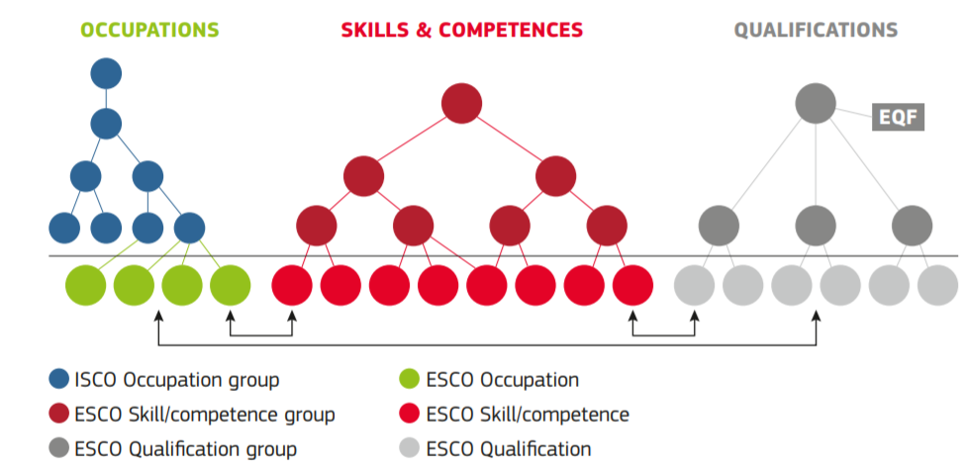
European Classification of Skills/Competences, Qualifications and Occupations

Slide 18
Example in excel

Slide 19
European Classification of Skills/Competences, Qualifications and Occupations
Professionals
Secondary education teachers
Mathematics teacher
Teaching Professionals
Business and administration
University teachers
Foreign laguage teacher
Chemistry teacher
All skills (13485)
Transversal skills
Digital competences
Language
Application of knowledge
Attitudes and values
Social interaction
Thinking
address an audience
lead others
motivate others
Attitudes
Values
persist
demonstrate enthusiasm
Education
Teacher training with subject specialisation
Professional Bachelor Degree in Mathematics, Teacher of Mathematics, Information Technology and Programming
Education
Inter-disciplinary programmes and qualifications involving education
Education Science
Professional Bachelor’s Degree in Education, Teacher of Foreign Language
Bachelor of Pedagogy
Training for pre-school teachers

Slide 20
Key points
Comparability
Connection between old and new classification;
International comparability;
Comparability with R&D classification;
Comparability with classification of occupations;
The same (or very strong connection) classification for Master and Bachelor specialities
Wide specialities
Update conditions

