Slide 1
Using labour market intelligence for higher education quality
Jolanta Silka
Deputy Head
Quality Agency for Higher Education

Slide 2
Development of new study programme
The autonomy of the higher education institutions
Based on:
  State educational standards
  Professional (occupational) standards (if applicable)
  General learning outcomes of the European/National Qualifications Framework Level
  Specific learning outcomes (defined by the higher education institution itself) in cooperation with employers
  Independent review of a labour market representative

Slide 3
Study programme cycle
  Latvian Confederation of Employers
  Sectoral Councils of Experts
  Professional organisations/associations
  provides expertise and opinion
Ministry of Economics “Report on medium and long-term forecasts on labour market needs”
  Current situation at the labour market
  Medium and long – term forecasts based on economy development and demography scenarios
New study programme development
Approval and submission for license
Licensing – initial assessment
Implementation/ reviewing
Accreditation
Improvements

Slide 4
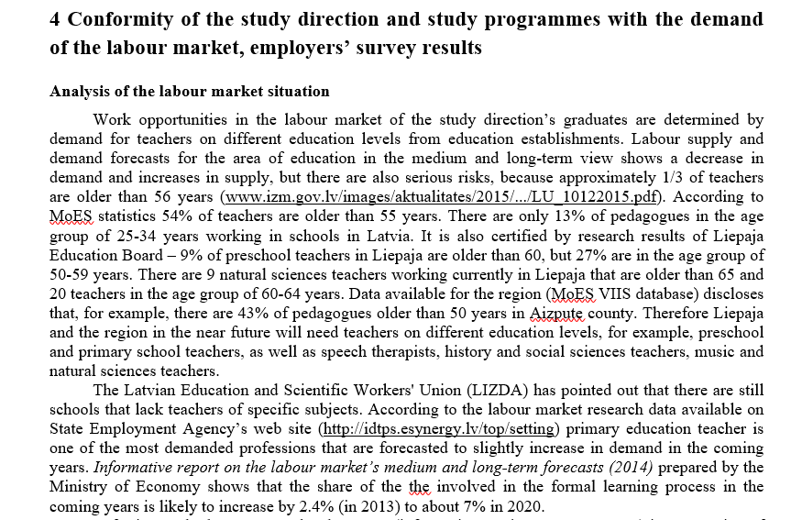
Example

Slide 5
State Educational Standards approved by Cabinet of Ministers
Strategic objective
reference to the EQF level
main (compulsory) parts of programmes
scope of programmes and their parts (duration and credits)
assessment principles
further education rights
State standard on academic education
Bachelor and master
State standard on 1st level professional HE
short cycle programmes
State standard on 2nd level professional HE
professional bachelor and master

Slide 6
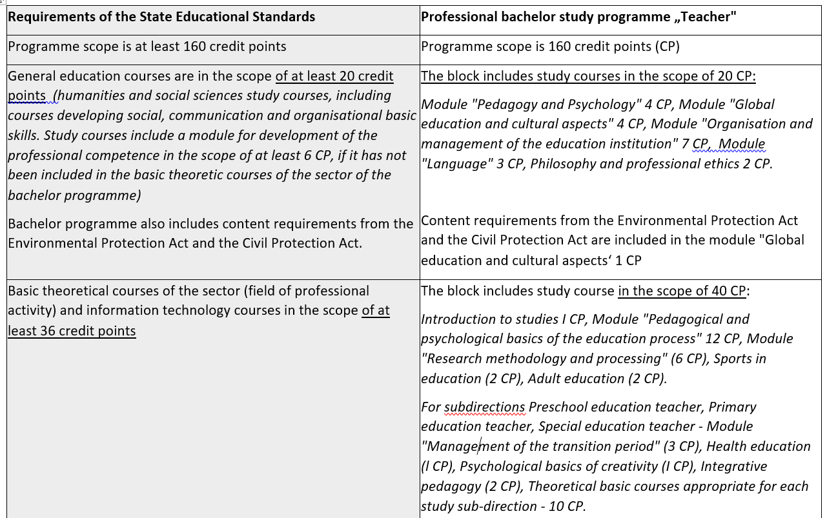
Example - Compliance with State Educational Standard
4 years studies, 160 CP – 240 ECTS, Professional bachelor degree in pedagogy and Teacher`s qualification

Slide 7
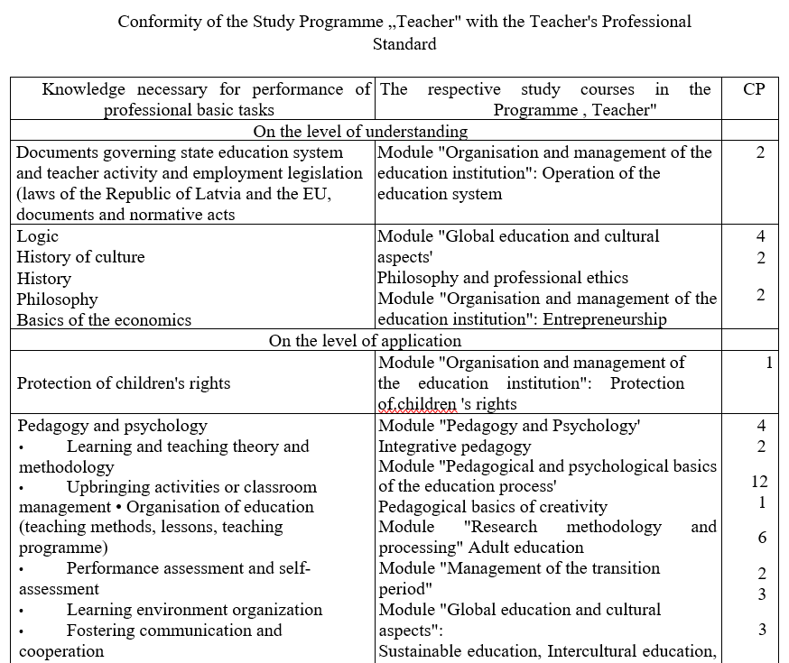
Compliance with labour market needs
Classification of occupations (professions)
Occupational standard or description of qualification –
knowledge, skills and competences to be acquired

Slide 8
Teacher – new occupational standard
Teacher – NQF/EQF 6 level
Professional requirements
Vocational education teacher, general secondary teacher, general primary education teacher, special education teacher, pre-school education teacher
Tasks and responsibilities of professional activity
Professional knowledge, skills and competences
Working group – Ministry Of Education and Science, Latvian Trade Union of Education and Science Employees, Latvian association of educational heads, several universities, organisation responsible for teachers further training and professional development, principles of schools etc.

Slide 9
Regular revision of study programmes
Committee/ Council (internal) including external stakeholders
Regular feedback from students/ graduates/ employers
VS-1-I Measurement of student general satisfaction
Every study year at the beginning of the second semester Student general satisfaction survey is carried out. Survey covers all students of LiepU. Survey results are available at LiepU QMS, results are prepared in both –the faculty perspective and for each study programme separately; Faculty Deans include them in Faculty Self-evaluation reports and study division self-evaluation reports. Overall student opinion and comments are available at LiepU QMS.
VS-1-II Measurement of employer satisfaction
Employer satisfaction at LiepU is analysed by means of enquiring Commission Chairs of final / state examinations as well as including questions in the practice evaluation form on theoretic knowledge of students, their practical skills and suggestions for further studies and work.
VS-1-III Measurement of graduates’’ satisfaction
Every year there is an electronic graduate survey based on the collected graduate contacts. Survey results are available at LiepU QMS, results are prepared in both –the faculty perspective and for each study programme separately and Faculty Deans include them in Faculty Self-development reports and study programme directors include them in study programme / study division self-evaluation reports.
Example

Slide 10
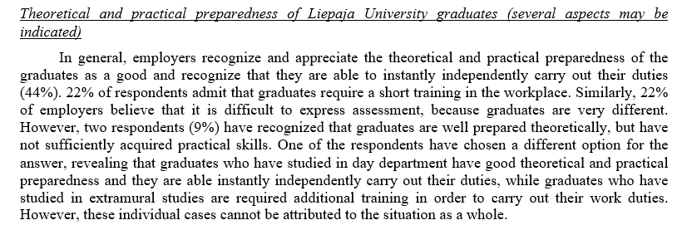
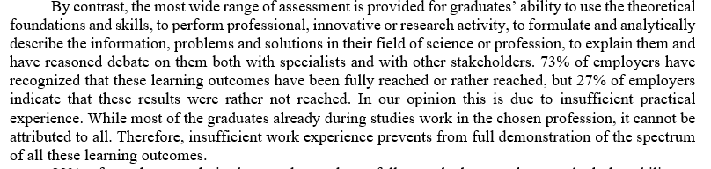
Example – analyses of employers survey

Slide 11
Thank you
jolanta.silka@aic.lv

