Slide 1
Reception of the delegation of Azerbaijan - CIEP
March 3, 2020

Slide 2
Paris Saclay University
14 members
Top 20 worldwide
65,000 students
9,000 researchers and EC (teachers & researchers)
8,000 publications per year
More than 10 % of French public research
4 600 doctoral students
25,000 Master's students
Foreign students and researchers: 23% of the total population of the university

Slide 3
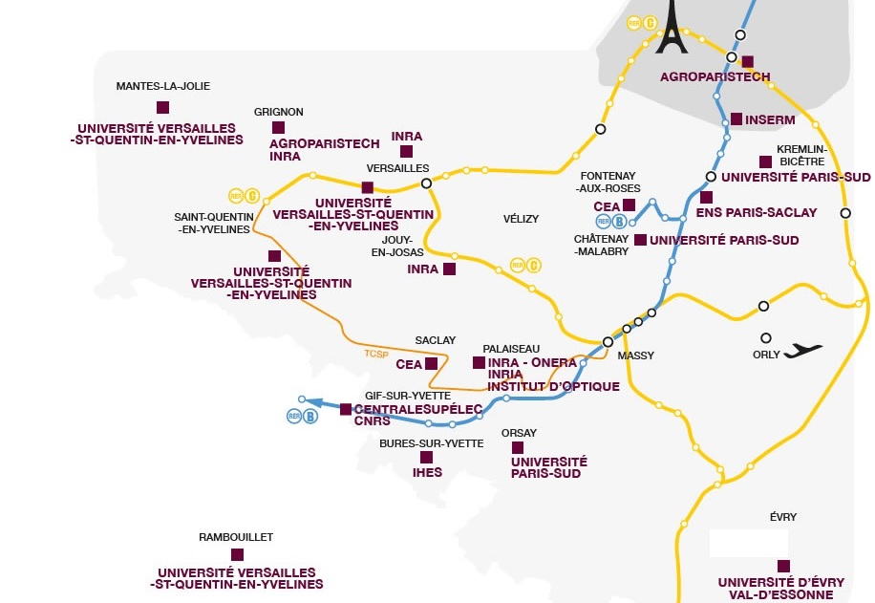

Slide 4
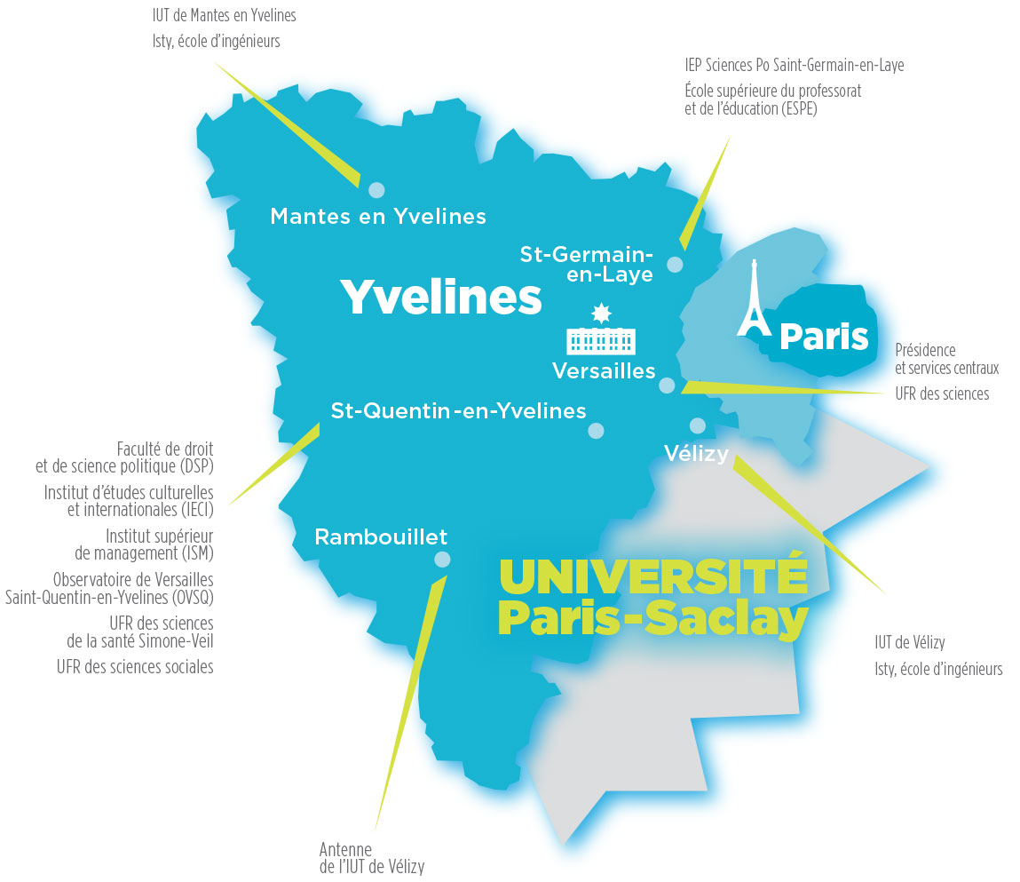
University of Versailles Saint-Quentin-en-Yvelines (UVSQ)
Founded in 1991:
Development of training programs 1st - 2nd cycle and professionalization;
Excellence in research: strategy of scientific development niches linked to a strong social and economic valorisation.
Participation in the economic, social and cultural planning and development of the Yvelines region.

Slide 5
19,000 Students in initial and continuing training
1,000 “Teachers-researchers” (MCF, PR)
540 Doctoral students 40% international
680 Administrative an Research Staff
220 International agreements
39 Research Structures

Slide 6
Missions (Education Code)
Initial and further training,
Scientific and technological research,
Dissemination of culture and scientific and technical information,
International cooperation,
Orientation and professional integration,
Participation in the construction of the European Higher Education and Research Area.
Principles (UVSQ)
Multidisciplinarity,
Pedagogical, scientific, administrative and financial autonomy,
Participation: democratic management with the help of all staff, students and external personalities.

Slide 7
Functioning
The President of the university with his decisions,
The Board of Administrators (CA) through its deliberations,
The Academic Council (CAC) with its proposals, opinions and wishes,
The Research Commission (CR) and the Commission for Education and University Life (CFVU) by their proposals, opinions, wishes and deliberations
The President is elected for 4 years by the elected members of the board of Administrators. He runs the University. He is assisted by Vice-Presidents, a General Director of Services and the Accounting Officer.
The General Director of Services participates in the development and implementation of institutional policy. He ensures its regulatory framework and its administrative management. He coordinates, organizes and modernizes all the administrative and technical services of the university.

Slide 8
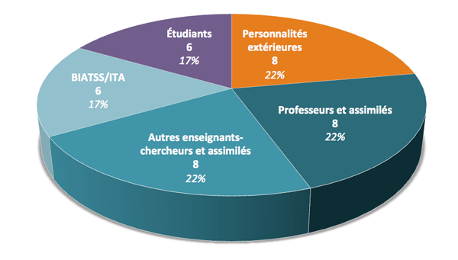
Composition of the CA : 36 members
Students
representatives
External
Stakeholders
representatives
Administrative &
technical staff
representatives
Academic staff
Representatives
Academic staff
Representatives:
Professors

Slide 9
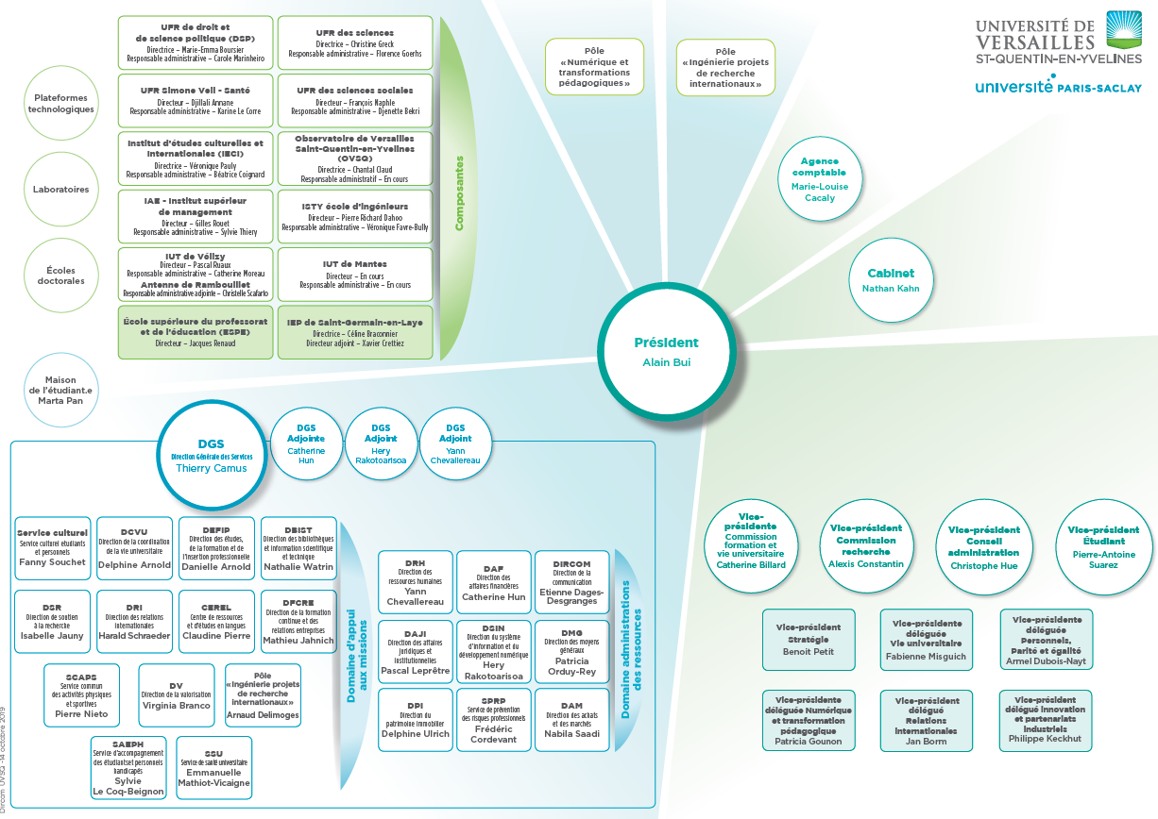

Slide 10
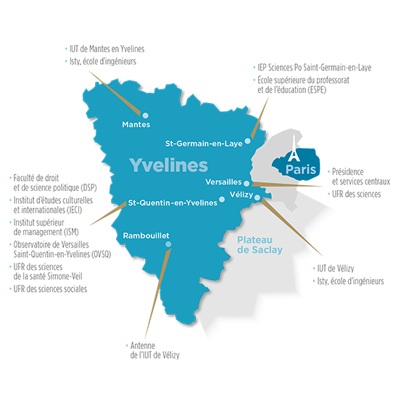
10 « Composantes » (Faculties) based on 8 sites in the department of Yvelines
5 « Unités de Formation et de Recherche » (Faculties)
Faculté de droit et de science politique (DSP)
UFR Simone Veil - santé
UFR des sciences
UFR des sciences sociales
Institut d'études culturelles et internationales (IECI)
1 Institut (L713-9)
ISM-Institut d’Administration des Affaires (ISM-IAE)
2 Instituts Universitaires de Technologie (IUT)
IUT de Mantes en Yvelines
IUT de Vélizy et son antenne à Rambouillet
1 École d’ingénieurs (L713-9) (Engineering School)
Institut des sciences et techniques des Yvelines (ISTY)
1 Observatoire des Sciences de l’Univers (OSU)
Observatoire de Versailles Saint-Quentin-en-Yvelines (OVSQ)

Slide 11
Training at the UVSQ
Multidisciplinary university: law, humanities, management, health, sciences for engineering, technology, etc. ;
in the top 3 of French universities for work-study programs and its proportion of apprentices;
More than 80% of master's graduates from the Institut Supérieur de Management (ISM-IAE) find a job within six months of graduation, depending on the course taken.

Slide 12
Research at the UVSQ
8 structuring and priority scientific axes :
Climate, environment, sustainable development ;
Culture and heritage;
Inflammation, infection, cancer;
Public health: epidemiology, ageing;
Disability;
Institutions, organizations and public policies;
Innovative materials: from their genesis to applications;
Modelling and simulation of complex systems.

Slide 13
The international dynamics of the UVSQ
More than 200 partnership agreements with universities in Europe and around the world: exchange programmes for students, but also for university teachers and researchers ;
Member of Paris-Saclay University (top 20): meeting the dual challenge of economic and technological competition and the acceleration of scientific developments at the global level;
A potential for innovative and international research (UVSQ joined the top 500 universities in the world in the Shanghai 2016 ranking):
Valorisation strategy linked to technology transfer;
Policy of professionalization and internationalization of training that give this university its character of excellence

Slide 14
The Institut Supérieur de Management
Institut d'Administration des Entreprises (ISM-IAE) within the UVSQ
UFR created in May 2010; IAE status since April 2018
LAREQUOI Management Research Laboratory, created in 1998, recognized as "Équipe d'Accueil" n° 2452;
20 training courses (state diploma courses) from the bachelor's degree to the doctorate;
Approximately 1,100 students, more than two-thirds of whom are in work-study programs and more than a hundred in continuing education;
Partnership with Apprenticeship Training Centers (CFA) of the Paris Ile-de-France Chamber of Commerce and Industry (ESSYM, Sup de Vente), with Proméo formation + MBA groups in continuing education with IFG (HR master), as well as with INET (MPT master) and IH2F (M@DOS master).

Slide 15
The ISM-IAE within the UVSQ
Core missions
- To develop research, training, dissemination and valorisation of knowledge and know-how in the various fields of management and management;
- To promote "responsible and integrated management";
- To organize and develop university and institutional cooperation:
- At the European and international levels;
- In terms of research, training and cooperation with the socio-economic environment, in particular in the economic basin where the UVSQ is located and in Saint-Quentin-en-Yvelines.
Development
- Openness to local, national and international environments ;
- Partnerships with public and private organizations and with companies;
- International development (Europe, America, Asia);
- Partnerships, for example, with Georgetown University (Washington D.C., USA), Matej Bel University, Banska Bystrica, University of Postdam, University of Chongqinq and Sofia University.
- Jean Monnet Chair;
- La Poste Chair "Quality and Customer Experience".

Slide 16
ISM-IAE Strategic Directions
- Continue and consolidate the territorial and local anchoring of the ISM-IAE;
- To deepen the articulation between research and training;
- To pursue international development;
- To dynamize the pedagogy and the organization of training in relation to the demands and needs;
- To continue the development of research, qualitatively and quantitatively.

Slide 17
Governance
ISM-IAE Board of Administrators;
Steering Committee;
Committee of “mentions” (Training programs);
General Assembly;
Laboratory Committee.
Decision-making and stakeholder information process
The two Annual General Meetings;
The Development Councils (for each training program, evaluation and continuous evolution);
Elections for the Board of Administrators
The solemn re-entry (Bachelor's and Master's) and graduation (Master's) ceremonies;
The ISM website and an Alumni scheme;
Meetings and conferences with professionals;
Targeted information for “tutors” and internship managers;
For research, the laboratory committee, the monthly doctoral workshops and plenary seminars as well as numerous scientific events (symposia, study days, etc).

Slide 18
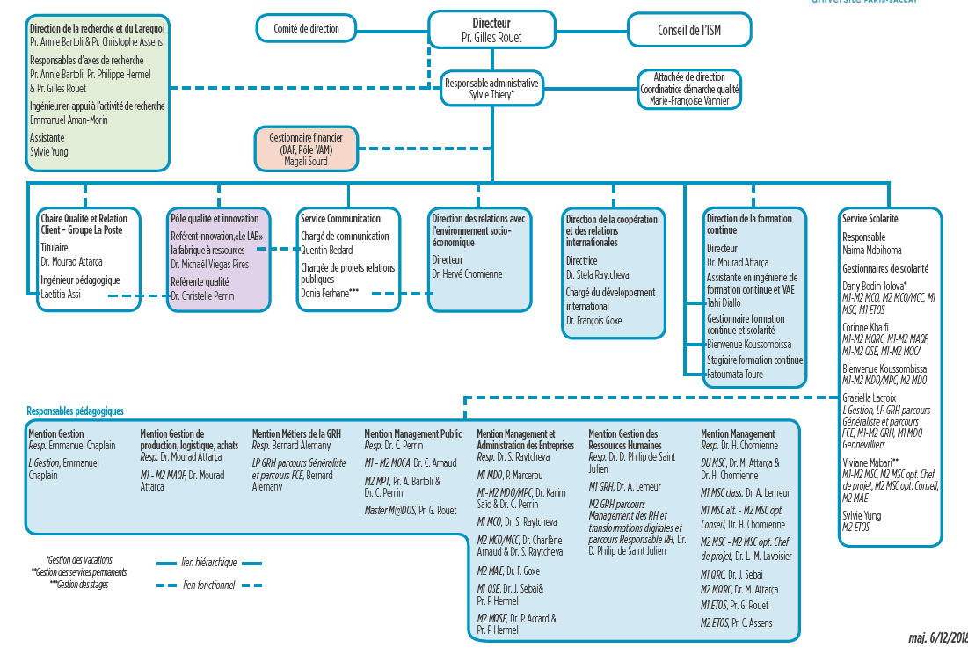

Slide 19
ISM-IAE : Training programs 2020-2025
Accréditation Saclay |  |  |  |  | Accréditation UVSQ
Mentions | Parcours | Sigles | Responsables |  | Mentions | Parcours | Sigles | Responsables
Gestion de Production, Logistique, Achat Mourad Attarça | Management des achats et de la qualité fournisseurs | GPLA-MAQF | Mourad Attarça |  | Licence Gestion Emmanuel Chaplain | Spécialisation progressive | LG | Emmanuel Chaplain
Marketing, Vente Florence Durieux | Management Relations Clients, Digital, Qualité | MV-MRCDQ | Mourad Attarça |  | Licence professionnelle RH Bernard Alemany | Assistant RH | LP-RH | Bernard Alemany
Management Stratégique Jean-Philippe Denis | Master of International Business | MS-MIB | Michael Viegas-Pires & François Goxe |  | Licence professionnelle RH Bernard Alemany | Formation Compétences Emploi | LP-FCE | Bernard Alemany
Management Stratégique Jean-Philippe Denis | Management, Stratégie et Changement | MS-MSC | Lydie-Marie Lavoisier & Hervé Chomienne |  | Management Hervé Chomienne | Évolutions technologiques organisationnelles et stratégiques | M-ETOS | Christophe Assens & Gilles Rouet
Contrôle de gestion et audit organisationnel Philippe Jacquinot | Management, contrôle et audit organisationnel | CGAO-MCAO | Karim Saïd |  | Management Hervé Chomienne | Management du Changement et Conseil en Organisation | M-MCCO | Hervé Chomienne
Gestion des Ressources Humaines Delphine de Saint-Julien | Management et développement des Ressources Humaines | GRH-MDRH | Delphine de Saint-Julien & Aline Lemeur |  | Management et Administration des Entreprises, Stela Raytcheva | Management Des Organisations | MAE-MDO | Christelle Thouvenot & Patricia Marcerou, Jihen Sebai & Gilles Rouet
Gestion des Ressources Humaines Delphine de Saint-Julien | Management des Ressources Humaines et Transformations Digitales | GRH-MRHTD | Delphine de Saint-Julien & Aline Lemeur |  | Management et Administration des Entreprises, Stela Raytcheva | Management Qualité, Sécurité, Environnement | MAE-MQSE | Jihen Sebai & Philippe Hermel
Communication des Organisation Stéphane Olivesi | Management et Communication des Organisations | CdO-MCO | Sela Raytcheva |  | Management et Administration des Entreprises, Stela Raytcheva | Administration des Entreprises | MAE-AE | François Goxe
 |  |  |  |  | Management Public Christelle Thouvenot | Management Public Territorial | MP-MPT | Christelle Thouvenot
 |  |  |  |  | Management Public Christelle Thouvenot | Management des Organisations Scolaires | MP-M@DOS | Gilles Rouet
 |  |  |  |  | Management Sectoriel Gilles Rouet | Management des Organisations Culturelles et Artistiques | MOCA | Corinne Brizard, Stela Raytcheva & Gilles Rouet

Slide 20
Pedagogy
Design of training programs and implementation according to the Programme-Skills approach
Establishment of an innovation pole and new pedagogical modalities development
Placement of our work-study students in companies and maintenance of the relationship with the apprenticeship supervisor by our CFA partners;
Planning of meetings with the apprenticeship masters by the heads of diplomas and CFA partners;
Mid-term reviews carried out with the students to improve the training offer and adapt it to professional developments;
Face-to-face or telephone interviews with company tutors by the CFA partners;
Regular exchanges between company tutors and diploma supervisors.

Slide 21
Diqqətinizə görə təşəkkür edirəm

