Slide 1

Centre for Educational Growth (CFEG)
of Rīga Stradiņš University

Slide 2

DEVELOPMENT OF THE CFEG
2014.
Establishment of a new structural unit to support the quality improvement by conducting regular study process analysis and organizing continuing education of academic staff.
2018.
1 – 3 EMPLOYEES
  Expansion of the goal and functions – to provide support for the modernisation of the study process and quality improvement.
  Objectives:
    analysis and supervision of the content & quality of study process;
    initiatives aimed at the achievement of development of the content of study programmes and the process in cooperation with internal & external partners;
    integration of pedagogical innovations at the level of study programmes and courses;
    pedagogical development of the teaching staff in systemic continuing education;
    implementation of academic and research activities within
13 EMPLOYEES

Slide 3
Enhancement of Educational Growth
Continuing Education of Academic Staff
Regular conduction of study process analysis (observation, focus groups, evaluation questionnaire, quality indicators of study programmes etc.)
Development of systemic needs-based approach on implementation of academics` continuing education.
Development of tailor-made content & diverse forms for educational activities.
Increase in number of participants, provided activities & its` frequency.
Strengthening of interdisciplinarity, internationalisation.
Promotion & implementation of research activities according to pedagogical development focuses
Internationalisation experience analysis
Analysis of student-centred learning & teaching practice.
Promotion of simulation-based approach.
Developing study innovation projects
Analysis of e-studies` pedagogical functionality
Integrating pedagogy session in RSU Scientific Conference
The Guidelines for Study Process Quality
Dissemination of Centre`s experience in international L&T events
Engagement in work of international networks
Involvement in Erasmus projects
Delivering study courses for students in the field of pedagogy

Slide 4
Enhancement of Educational Growth
Continuing Education of Academic Staff
Study Process Quality Analysis
Study Innovation Project
systemic analysis of the data related to the content and process of studies - Study result mapping, grade analysis, student flow etc.;
support of the development of new study programmes, licensing and accreditation and supervision of the improvement of the existing study programmes;
monitoring of the development of study course descriptions (content quality, timely submission, regular renewal)
pedagogical functionality of RSU e-studies – learning analytics, implementation of innovations, providing advisory support.
Methodologically argumented field analysis – students`, academics` perspective, performance indicators.
Improvement of systemic needs-based approach on implementation of academics` continuing education – innovative hands-on training, distance learning, variety of individualised activities, expansion of integration of international experience, content targeting to strengthen development initiatives, partnership with internal & external stakeholders.
Improvement of continuing education administration platform – registration, visualisation of participants data (academic hours, certificates, learning materials etc.).
Structured library of audio, video records.
Stabilising amount of participants & representation.
provide pedagogical advisory support to representatives of academic departments;
development of thematic didactic materials
enlargement local and international cooperation with stakeholders in order to promote provision of resources for improving the quality of studies;
carry out educational research facilitating research-based studies.
Initiation and realisation of pedagogical innovation projects – The School of Junior Academics, Framework of Academic Integrity, promoting academic leadership through gamification, technology enhanced learning, Repository of study materials, Development of educational clinical case simulation tool, Skills monitoring system.

Slide 5
_{DIGITALISATION}
TOPICS
OF CONTINUING EDUCATION
EMBEDDED
TRANSVERSAL
FOCUSES
_{INTERDISCIPLINARITY}
_{STUDENTCENTREDNESS}
Recognizing & Sharing Good Practice
_{SIMULATION-BASED EDUCATION}
_{INTERNATIONALISATION}
Curriculum Design
Evidence-based Practices
_{Highschool}
_{Didactics}
Study Outcome Assessment & Feedback
_{Educational Management}
Digital Skills & Educational Technologies
Information and Communication Technology skills
Teaching & Learning
_{General Skills}

Slide 6
Forms of educational activities:
Theoretical courses (definition and assessment of study results; learning content design; international relations, data protection - GDPR issues in study process)
Hands-on training (How to use e-studies; Research methodology and statistical data analysis – R, Envivo, SPSS; How to find information in databases; acquiring digital tools – Ms Excel, Powerpoint, Endnote; TurnItin, Panopto, data visualisation platforms, feedback, polling, audience management tools, video capturing)
Practical workshops – How to design a study course; Supervision of the study programme.
Creative seminars – strengthening public speech skills, improvising in pedagogical work; visual culture;
Guest lectures and seminars – Building a Feedback-Rich Culture; Learning environment – how to make it effective and motivating; Contextualizing the use of Webinar in Higher Education; Creating Engaging and Interactive Classrooms through Active Learning Techniques.
Experience sharing – story telling (students, lecturers, alumni) “I am a lecturer/student/alumni, let`s introduce ourselves”.
Supervision sessions for study course supervisors, study programme directors, heads of units.
Consulting and mentoring – experienced ones observe and consult junior academics; learning & teaching advisors provide consultations academics about approaches, methods, techniques etc.
Notes:
Organisation:
Quantitative needs analysis once a year. The plan of educational activities is made for a semester.
Approx. 5 guest lecturers are invited during academic year.
Ratio of unique and recurring activities ~ 60:40.
~ 60 thematic learning activities are made annually (~ 450 academic hours; ~ 4 activities a week).

Slide 7
EMERGENCY REMOTE TEACHING & LEARNING AT RSU
13.03.20. REMOTE LECTURES
All lectures are executed online only. Classes are still done on campus.
16.03.20. STUDY PROCESS ENTIRELY ONLINE
The study process is organised remotely according to the lecture and class timetable for the term. Changes, if they are unavoidable, are permitted only with the dean’s explicit consent.
BY 20.03.20. ALL INFORMATION MADE AVAILABLE ON E-STUDY PLATFORM
BY 01.06.20. ALL STUDY MATERIALS TRANSFERRED TO E-STUDY PLATFORM
By 20.03 the Heads of study courses must ensure all information concerning remote study organisation is placed on the E-study platform. Deans, Heads of study programmes and departments must monitor this execution.
The transfer is executed by the Heads of academic units, study programmes, study courses and the Deans of Faculties. Study Department and Centre for Educational Growth are monitoring the progress.
Notes:
Sprintu laika līnija

Slide 8

WEBINARS ON:
Digital tools – Zoom, Panopto, Feedback tools – e. g. Mentimeter, Google Apps, Moodle, Respondus Monitor.
Practical issues – how to organize online teaching: from pedagogical approach (practical tips) to technological tools.
Emotional issues – how to work online in a healthy manner.
Regular exchange of experience - dos and don’ts.
INDIVIDUAL CONSULTATIONS
Practical assistance of e-study content administrator on individual basis
Learning & Teaching advisors – technical issues; pedagogical solutions; organisational advises.
DIDACTIC MATERIALS
Dynamic Section «Most frequently asked questions» related to remote teaching.
Materials published in RSU e-studies course “Support to remote study process”.
SUPPORT PROVIDED TO ACADEMIC STAFF DURING THE EMERGENCY SITUATION COVID 19

Slide 9
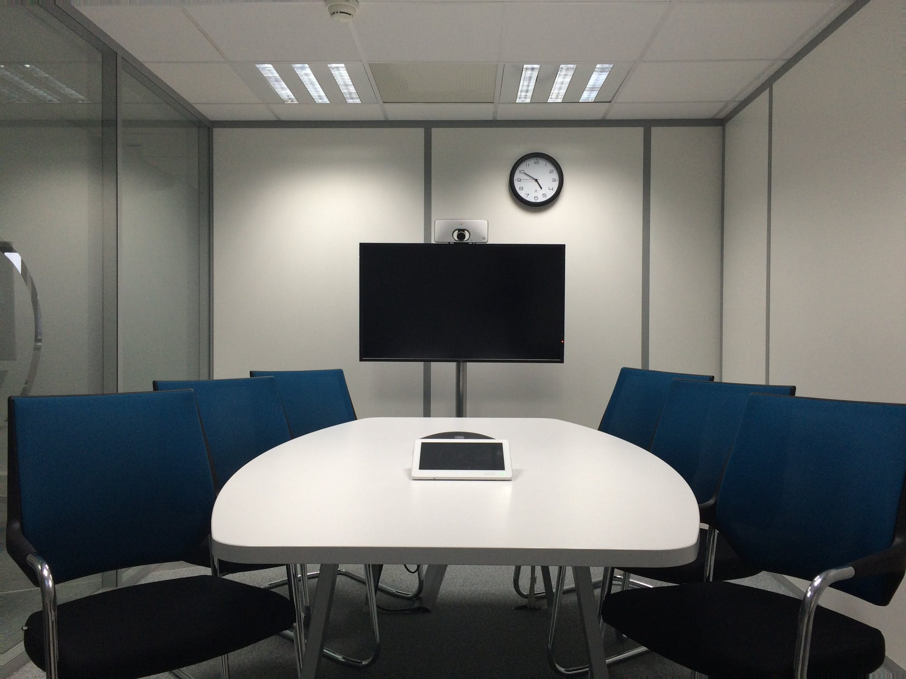
ANALYSIS AND EXPANSION OF ONE’S OWN CAPABILITIES

