Slide 1
Twinning project ENI/2018/395-401, AZ/14/ENI/OT/01/17 (AZ/49) Support to strengthening the higher education system in Azerbaijan
28 – 20th February, 2020
Learning outcome assessment

Slide 2
Learning outcomes
After the session you will be able to:
Plan competence assessment in study program based on LOs
Give examples of different summative assessment methods and choose them for LO assessment
Understand concept of formative assessment and choose it for student learning facilitation

Slide 3
What is the relation between competence and learning outcomes?
EXAMPLE
Comptence: communication
Course: academic writing I
Course: academic writing II
Course: academic writing III
Will be able to...
write a short report of
lab assignment
Will be able to...
write a course work
on selected topic
Will be able to...
write thesis on original
research and discuss results
Course: oral presentation and communication
Will be able to...
Make short oral presentation
Will be able to...
Make oral presentation to different
audiences using proper language
Will be able to...
Discuss topics with colleagues
and use scientific argumentation
Study year I
Study year II
Study year III
Study year IV

Slide 4
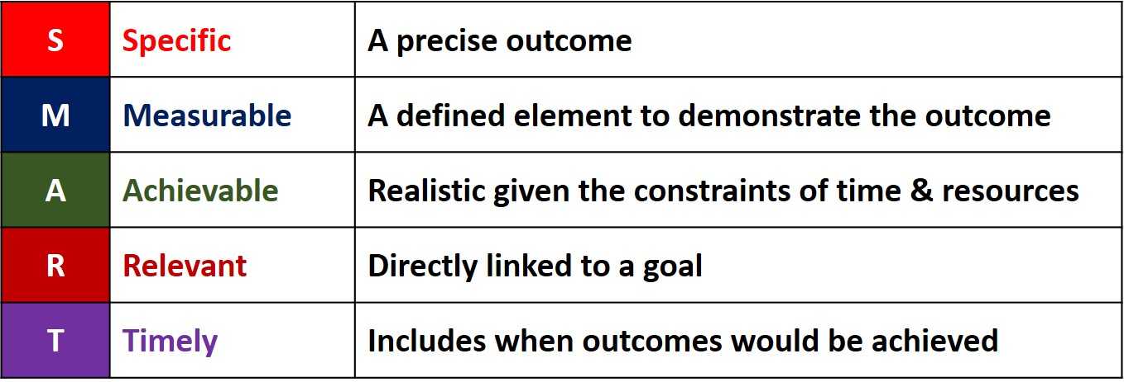
Learning Outcomes should be SMART:

Slide 5
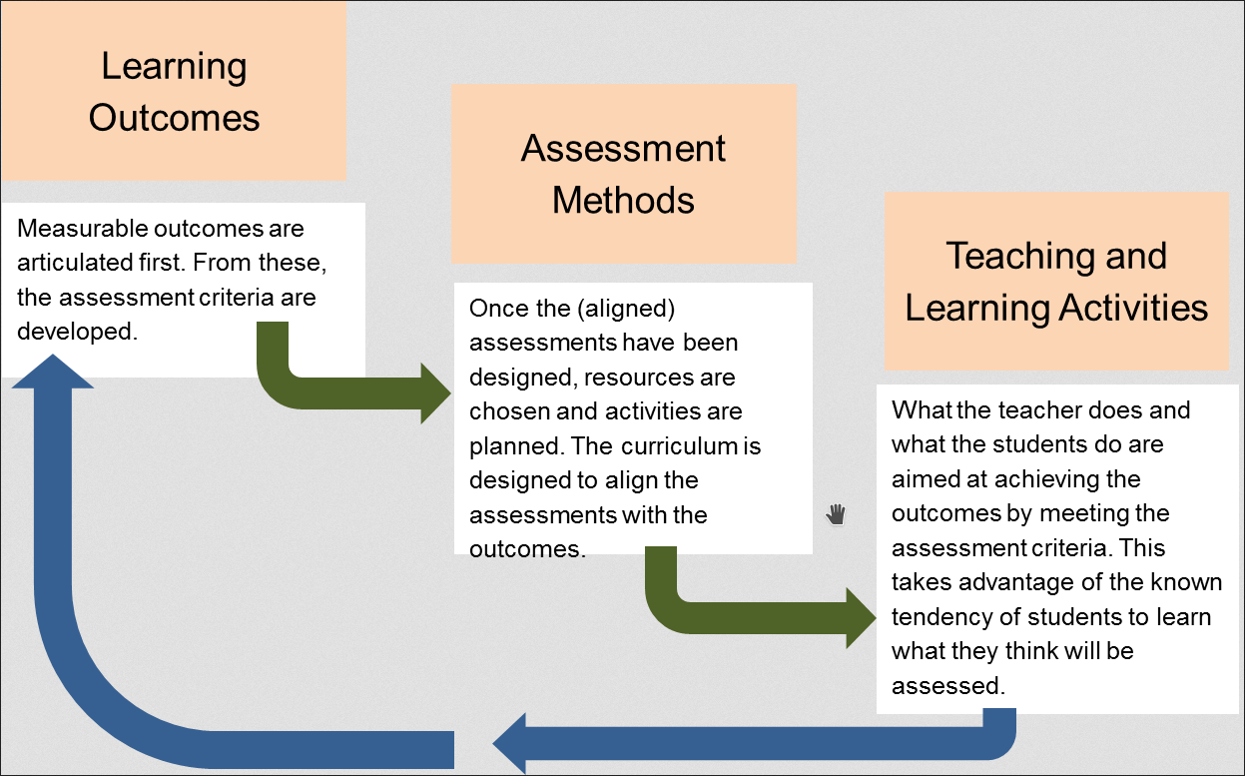

Slide 6
Assessment drives learning!
Regardless of formal information,
students allways learn what they think
is needed for exams...

Slide 7
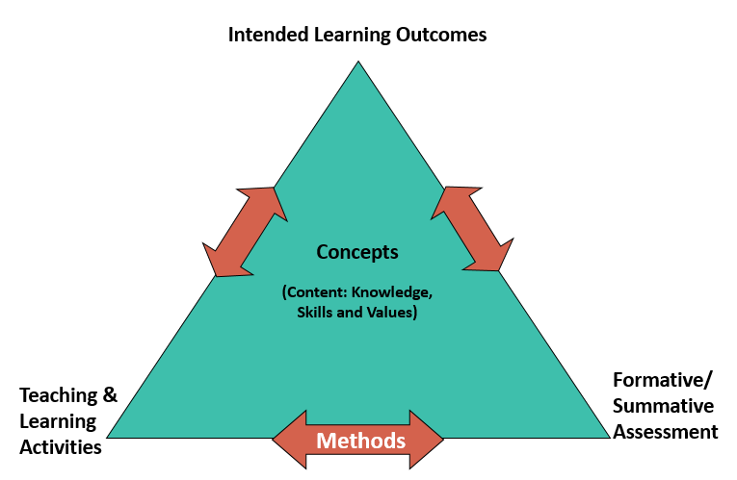
http://www.queensu.ca/teachingandlearning/modules/assessments/18_s2_10_revisiting_learning_outcomes.html

Slide 8
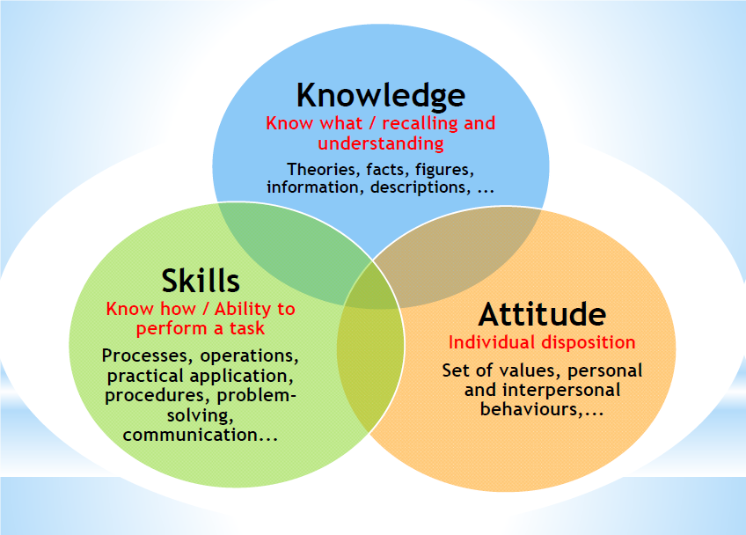

Slide 10
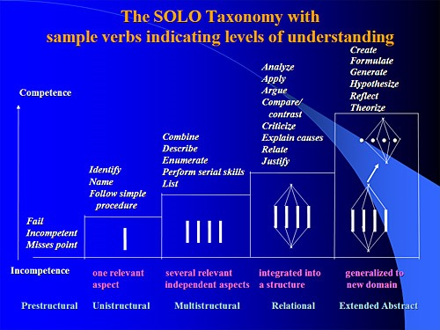
SOLO Taxonomy
(Structure of Observed Learning Outcomes)
https://eductechalogy.org/2017/07/03/forget-blooms-heres-to-solo-teaching/

Slide 11
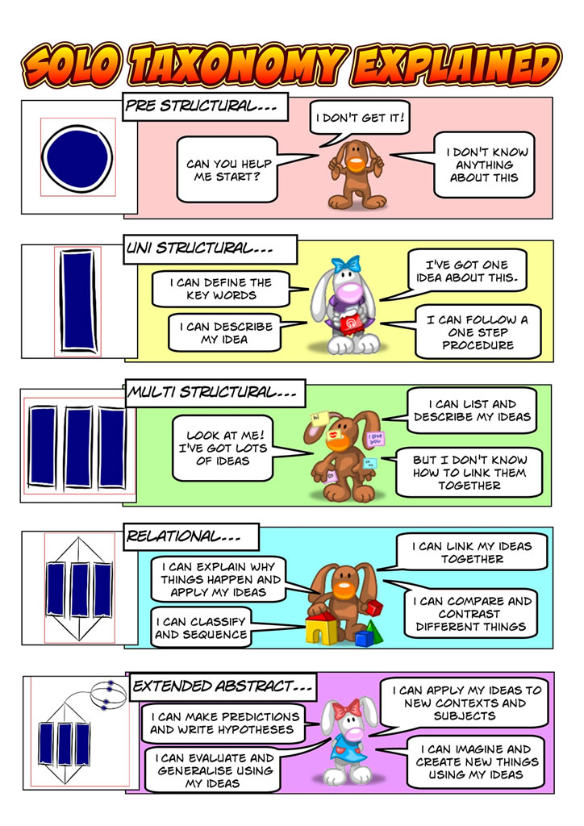
SOLO Taxonomy
(Structure of Observed
Learning Outcomes)

Slide 12
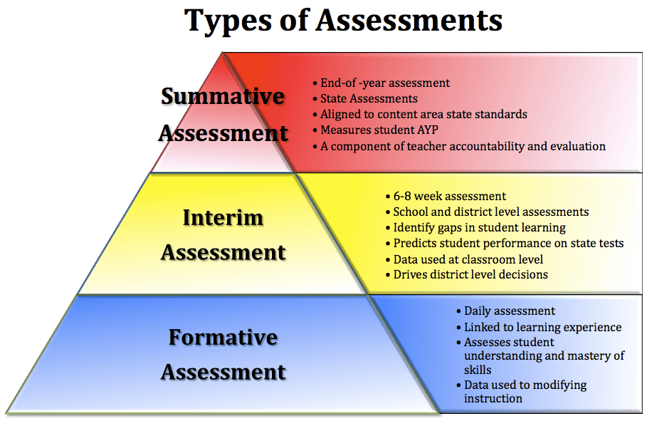

Slide 13
Assessment methods (AM) set by the new Azerbaijan State Standards
for Studies Programmes):
E-study methods
written assignments
tests of knowledge and skills, computer-based tests
continuous monitoring of knowledge
oral presentations
public discussions
work placement reports, fieldwork reports
assessment of skills based on observations in work placements, laboratories
project work reports
professional portfolios assessment
peer assessment
demonstrations in simulated environment
collegiate and self-assessment
……………..
……………….

Slide 14
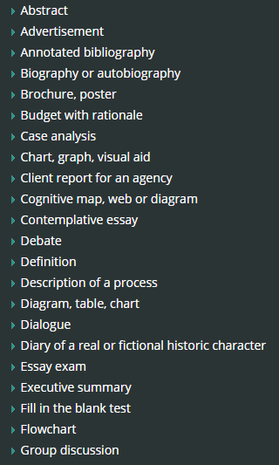
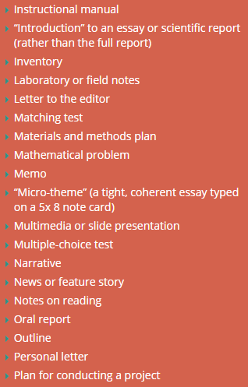
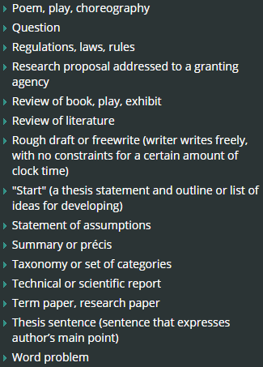
http://www.queensu.ca/teachingandlearning/modules/assessments/19_s2_11_sample_assessment_methods.html
http://www.queensu.ca/teachingandlearning/modules/assessments/09_s2_01_intro_section.html
Sample Assessment Methods

Slide 15
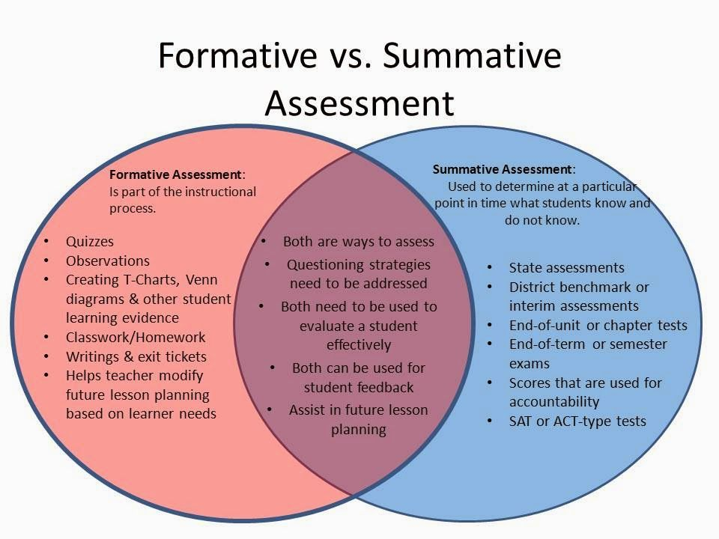

Slide 16
ASSESSMENT TYPES: Diagnostic, Formative and Summative
http://www.queensu.ca/teachingandlearning/modules/assessments/09_s2_01_intro_section.html
Sample Assessment Methods
Designing Authentic Assessments
Examples of Innovative Assessments
Involving Students in the Assessment Process

