Slide 1
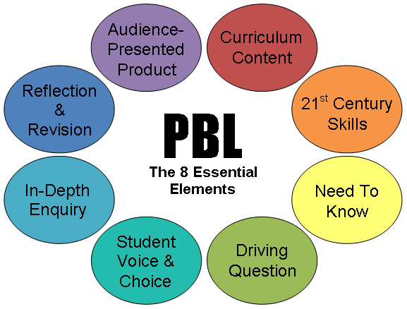
Problem based learning
Student roles:
Leader
Secretary
Group members
Scenario:
Real life situation with
“trigers” to encourage
learning
Process:
models of several
“steps” or “jumps”
Settings:
Rooms for groupwork,
Information resources

Slide 2
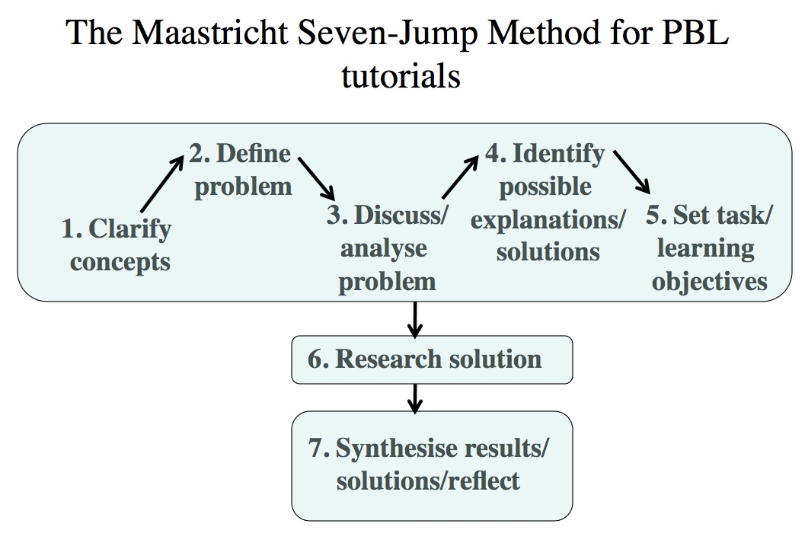

Slide 3
Traditional learning
„Teacher“
„Students“

Slide 4
Problem based learning
„Tutor“
„Students“

Slide 5
In relation to curriculum design Problem–Based Learning (PBL)
allows for some choice within a programme of areas that students may study
it allows students to set some of their own learning objectives/outcomes, dependent on prior knowledge.
the importance of attempting to focus on the needs of the students at the early stage of curriculum design

Slide 6
This aspect of responsibility aligns with the Lea et al. (2003) view that ”Problem–based (also case-based) learning is higher up the student choice aspect of the SCL than the usual problem–solving or problem–oriented exercises performed in by lecture/tutorial”.
SCL involves ‘increased responsibility and accountability on the part of the student’ .

